Slide 1
Juniper Apstra 4.2.1 EVE-NG Virtual Lab Demo Video series companion guide Video 7: Day-1 Over-the-top DC Interconnect
Colin Doyle, Sr. CE AMER
See the complete video walkthrough on YouTube at: https://www.youtube.com/@5minutejunos
Ask questions at the Juniper Elevate Community using the hashtag #5minutejunos
Adapted from v4.0.0 documentation originally compiled by: - Raymond Lam, SSE APAC - Tony Chan, SSE APAC

Slide 2
Agenda
Prepping your Lab
Day-0 Fabric Onboarding
Virtual Device Profile Verification
Virtual Device Profile Cloning
Onboarding Virtual Nodes
Create ASN Pool and IP Pools
Create Logical Devices and Interface Maps
Create Rack Types
Create Templates
Create Blueprints
Day-1 Service Provisioning
Create Routing Zones
Create Virtual Networks
Assign Virtual Network to Switchports
Add Server Links
Data Center Interconnect
DCI Addendum: Direct Peering
Core/WAN Connectivity
Internet Connectivity
Day-2 Operational Scenarios
Incorrect Cable Patch (RCA, LLDP Link Discovery, Time Voyager)
Config Deviation Checking
Apply custom config through Configlet
View Telemetry Data
Hardware Replacement
Future Documentation
Firewall Service Chaining
Cluster with Service Block
Type-5 Route (fabric integrated) with MNHA
VLAN Stitching
vEvo Fabric

Slide 3
Day-1 Service Provisioning
Create Routing Zones
Create Virtual Networks
Assign Virtual Network to Switchports
Add Testing Hosts
Data Center Interconnect (OTT)
DCI Addendum – Direct Peering
Core Connectivity
Internet Connectivity

Slide 4
Data Center Interconnect #1 – Underlay
We will be provisioning an Over-The-Top (OTT) DCI for this lab. The border leafs will peer with the external vMX routers to exchange fabric loopback reachability routes. Once the border leafs in each fabric have loopback reachability, we can peer them directly to exchange routes between DC fabrics.
Below diagram illustrates the topology of the data center after this section.
Unmanaged by Apstra, created in blueprints as external generic systems
ext-rtr1
eBGP peer, preconfigured in the setup
ext-rtr2
External links added in this section to exchange loopback address
ge-0/0/3
ge-0/0/3
ge-0/0/3
ge-0/0/3
A-border1
A-border2
B-border1
B-border2
A-spine1
A-spine2
B-spine1
B-spine2
A-leaf1
A-leaf2
B-leaf1
B-leaf2

Slide 5
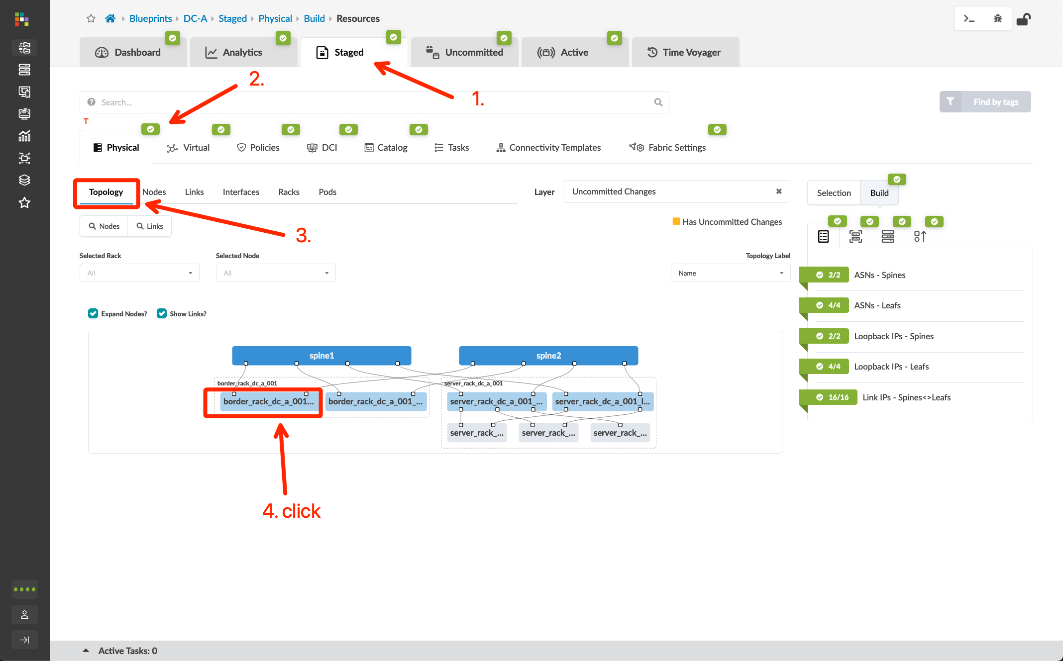
Data Center Interconnect #1 – Underlay
Go to Blueprints > DC-A > Staged > Physical > Topology and click “border_rack_dc_a_001_leaf1”
Click the checkbox for the border rack node and select “Add internal/external generic system”
Create a new external generic system called ext-rtr1, select “None” for the device representation, and click “Next”
Select port 3 on each border leaf, click the port icon followed by the “Add Link” button for each, then click “Create”
Click the "ext-router", open the properties page and edit its ASN, update it to 65001. If you skip this step, Apstra will ask you to assign a ASN resource pool to external generic system at later stage
Go to Blueprints > DC-A > Staged > Policies > Routing Policies, and click “Create Routing Policy”
Name: ext-router-policy
Import Policy: Extra Only
Extra Import Routes:
Export Policy: Loopbacks only
Prefix | GE Mask | LE Mask | Action
192.168.1.0/24 | 32 |  | Deny
0.0.0.0/0 | 32 |  | Permit

Slide 6
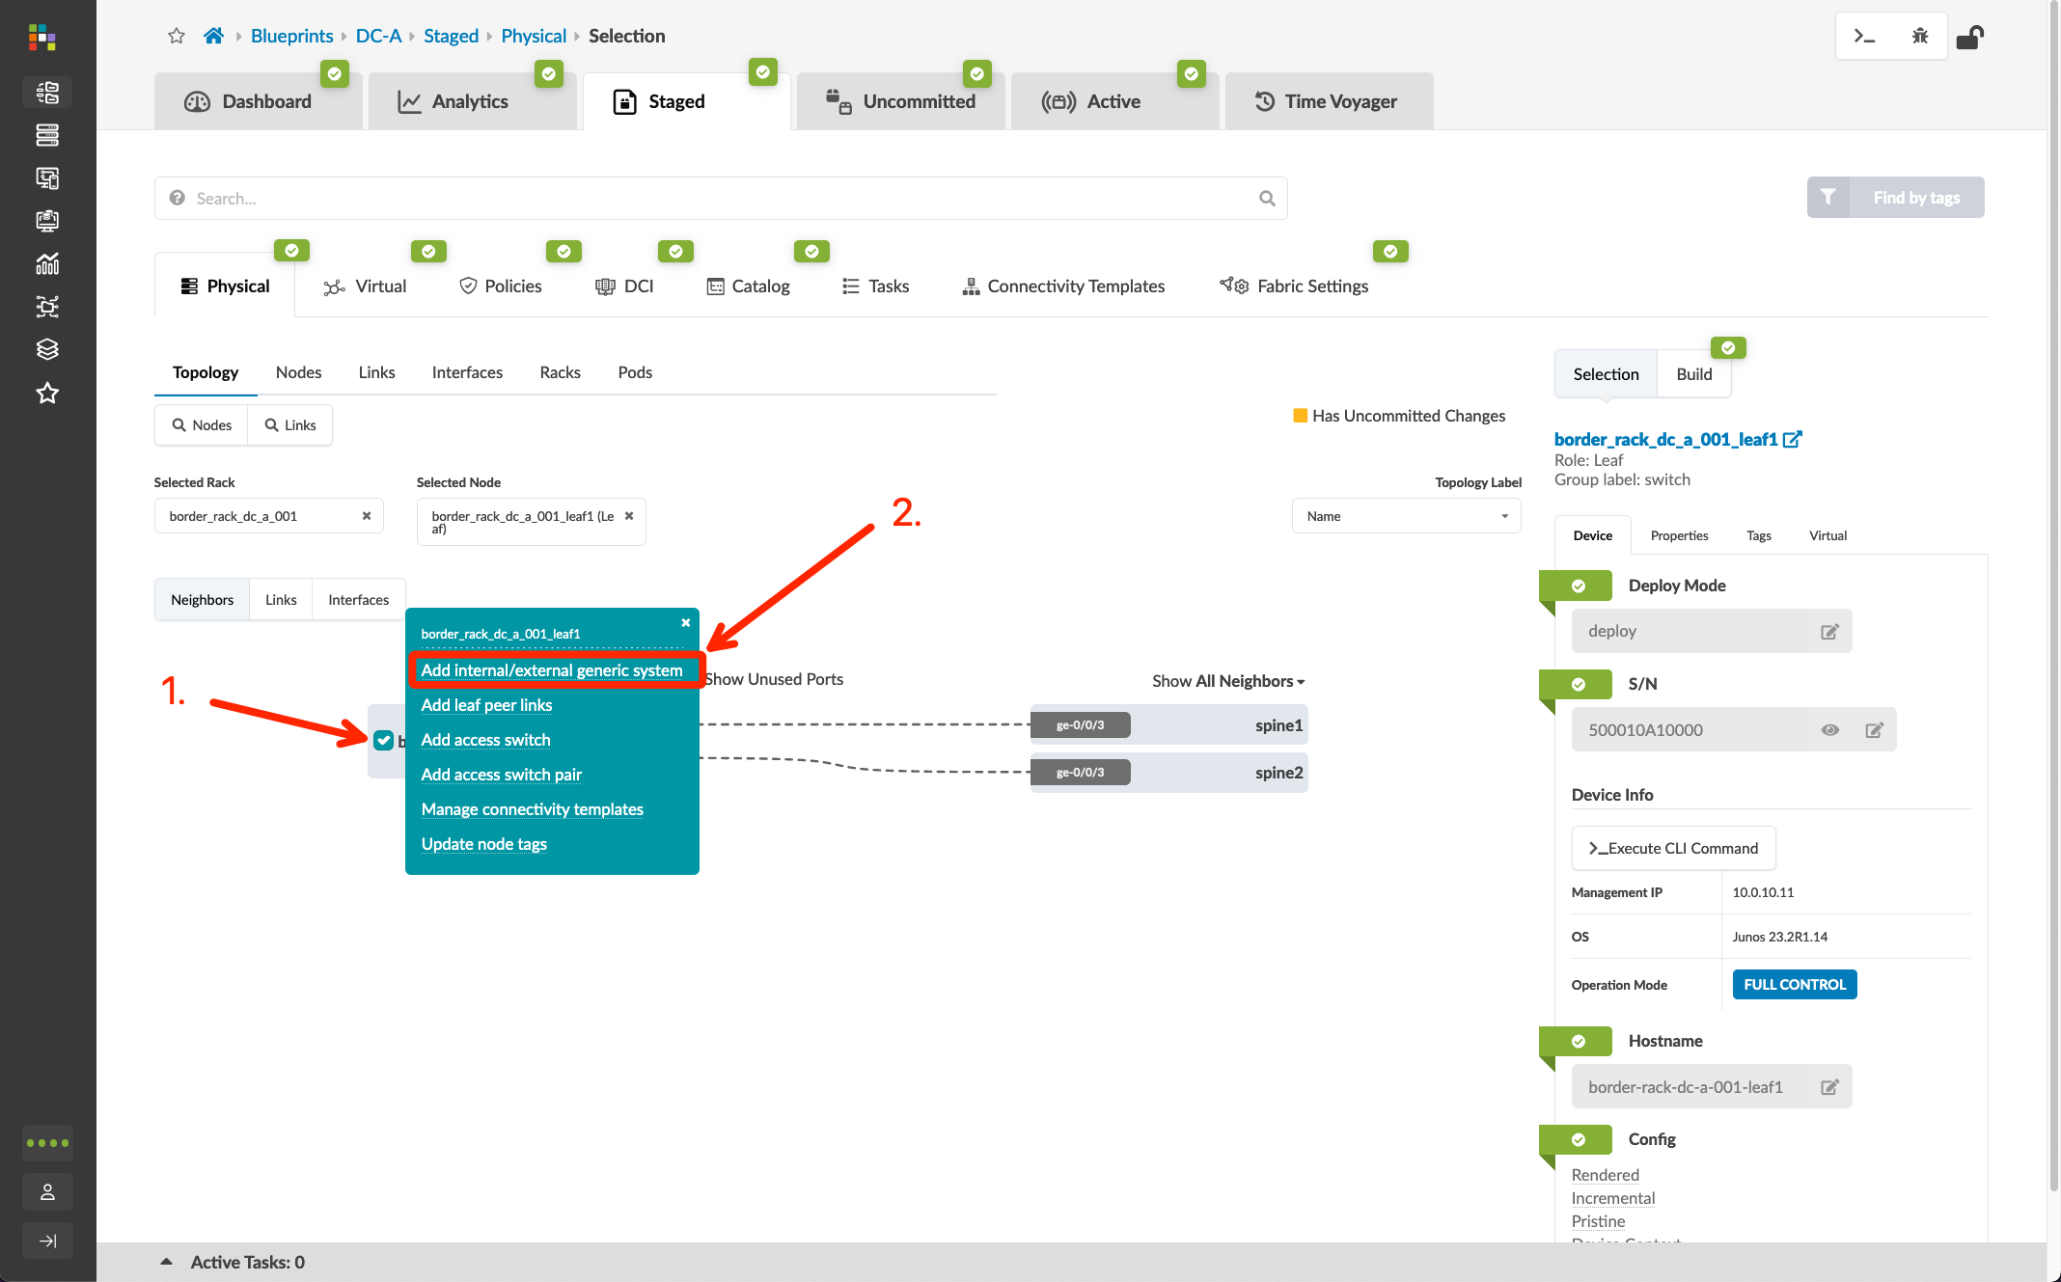
Data Center Interconnect #1 – Underlay
Go to Blueprints > DC-A > Staged > Physical > Topology and click “border_rack_dc_a_001_leaf1”
Click the checkbox for the border rack node and select “Add internal/external generic system”
Create a new external generic system called ext-rtr1, select “None” for the device representation, and click “Next”
Select port 3 on each border leaf, click the port icon followed by the “Add Link” button for each, then click “Create”
Click the "ext-router", open the properties page and edit its ASN, update it to 65001. If you skip this step, Apstra will ask you to assign a ASN resource pool to external generic system at later stage
Go to Blueprints > DC-A > Staged > Policies > Routing Policies, and click “Create Routing Policy”
Name: ext-router-policy
Import Policy: Extra Only
Extra Import Routes:
Export Policy: Loopbacks only
Prefix | GE Mask | LE Mask | Action
192.168.1.0/24 | 32 |  | Deny
0.0.0.0/0 | 32 |  | Permit

Slide 7
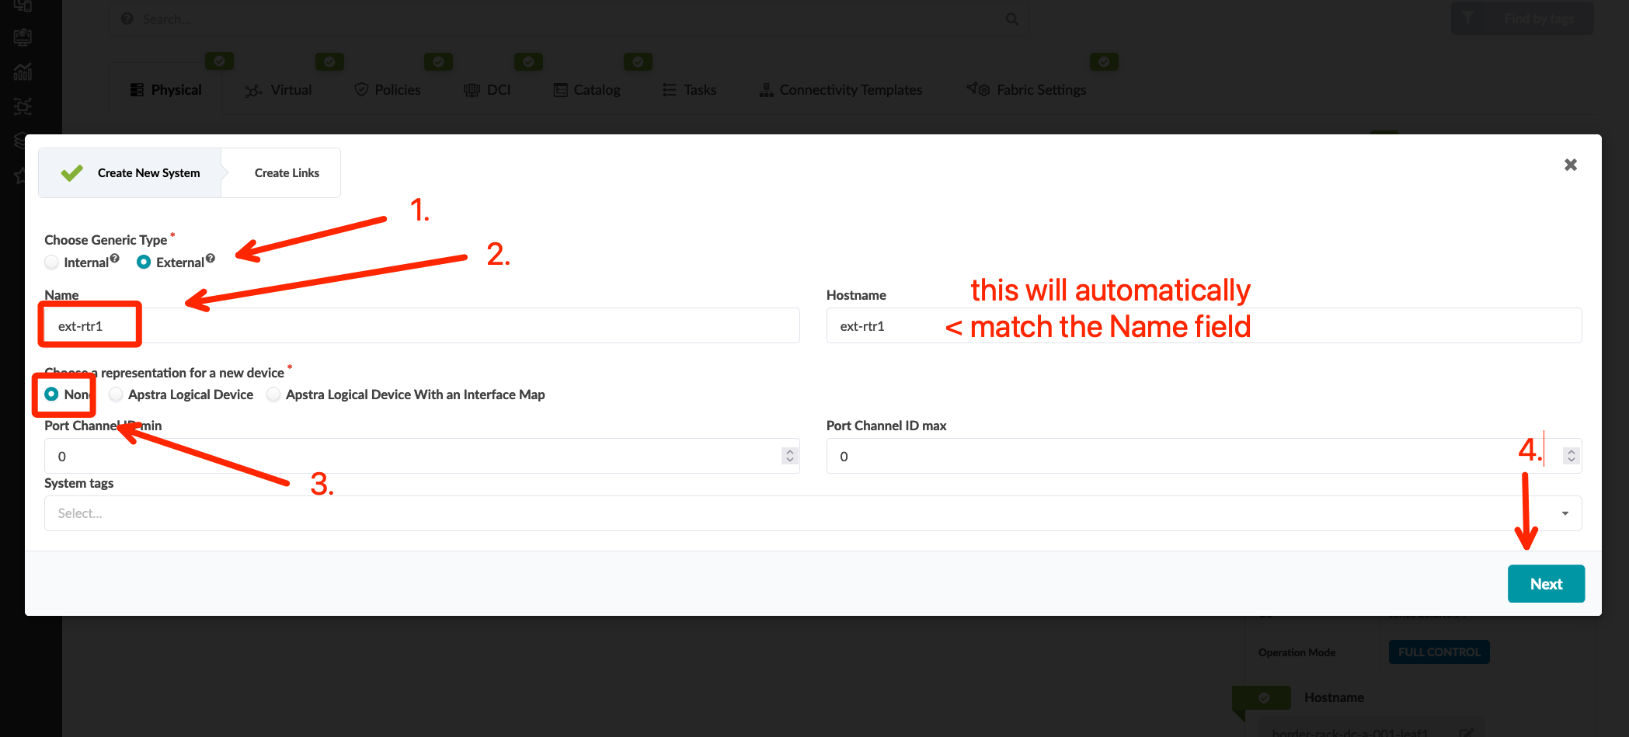
Data Center Interconnect #1 – Underlay
Go to Blueprints > DC-A > Staged > Physical > Topology and click “border_rack_dc_a_001_leaf1”
Click the checkbox for the border rack node and select “Add internal/external generic system”
Create a new external generic system called ext-rtr1, select “None” for the device representation, and click “Next”
Select port 3 on each border leaf, click the port icon followed by the “Add Link” button for each, then click “Create”
Click the "ext-router", open the properties page and edit its ASN, update it to 65001. If you skip this step, Apstra will ask you to assign a ASN resource pool to external generic system at later stage
Go to Blueprints > DC-A > Staged > Policies > Routing Policies, and click “Create Routing Policy”
Name: ext-router-policy
Import Policy: Extra Only
Extra Import Routes:
Export Policy: Loopbacks only
Prefix | GE Mask | LE Mask | Action
192.168.1.0/24 | 32 |  | Deny
0.0.0.0/0 | 32 |  | Permit

Slide 8
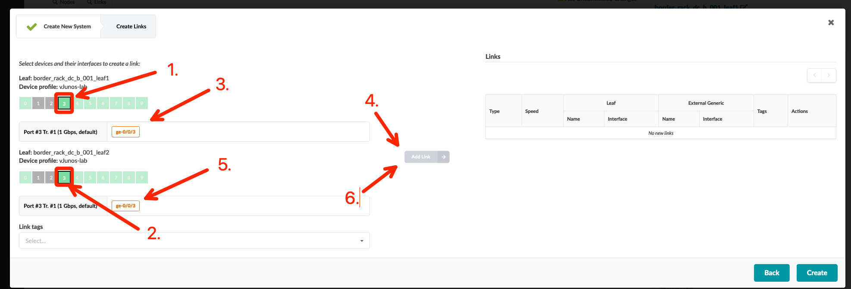
Data Center Interconnect #1 – Underlay
Go to Blueprints > DC-A > Staged > Physical > Topology and click “border_rack_dc_a_001_leaf1”
Click the checkbox for the border rack node and select “Add internal/external generic system”
Create a new external generic system called ext-rtr1, select “None” for the device representation, and click “Next”
Select port 3 on each border leaf, click the port icon followed by the “Add Link” button for each, then click “Create”
Click the "ext-router", open the properties page and edit its ASN, update it to 65001. If you skip this step, Apstra will ask you to assign a ASN resource pool to external generic system at later stage
Go to Blueprints > DC-A > Staged > Policies > Routing Policies, and click “Create Routing Policy”
Name: ext-router-policy
Import Policy: Extra Only
Extra Import Routes:
Export Policy: Loopbacks only
Prefix | GE Mask | LE Mask | Action
192.168.1.0/24 | 32 |  | Deny
0.0.0.0/0 | 32 |  | Permit

Slide 9
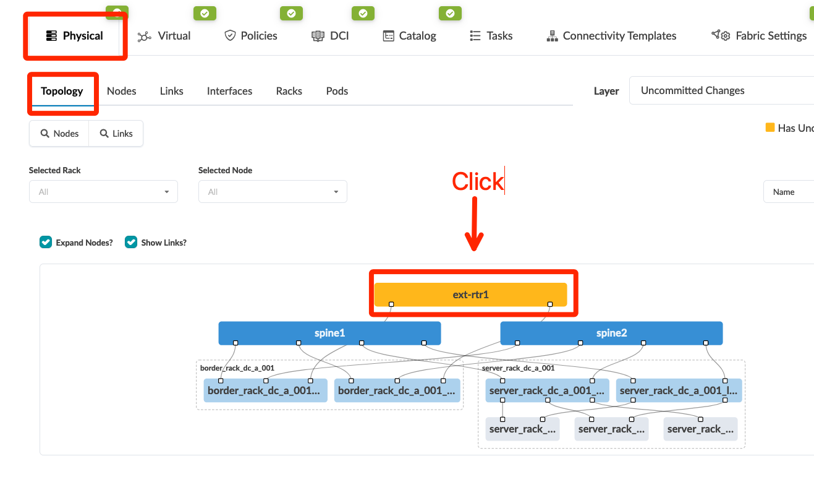
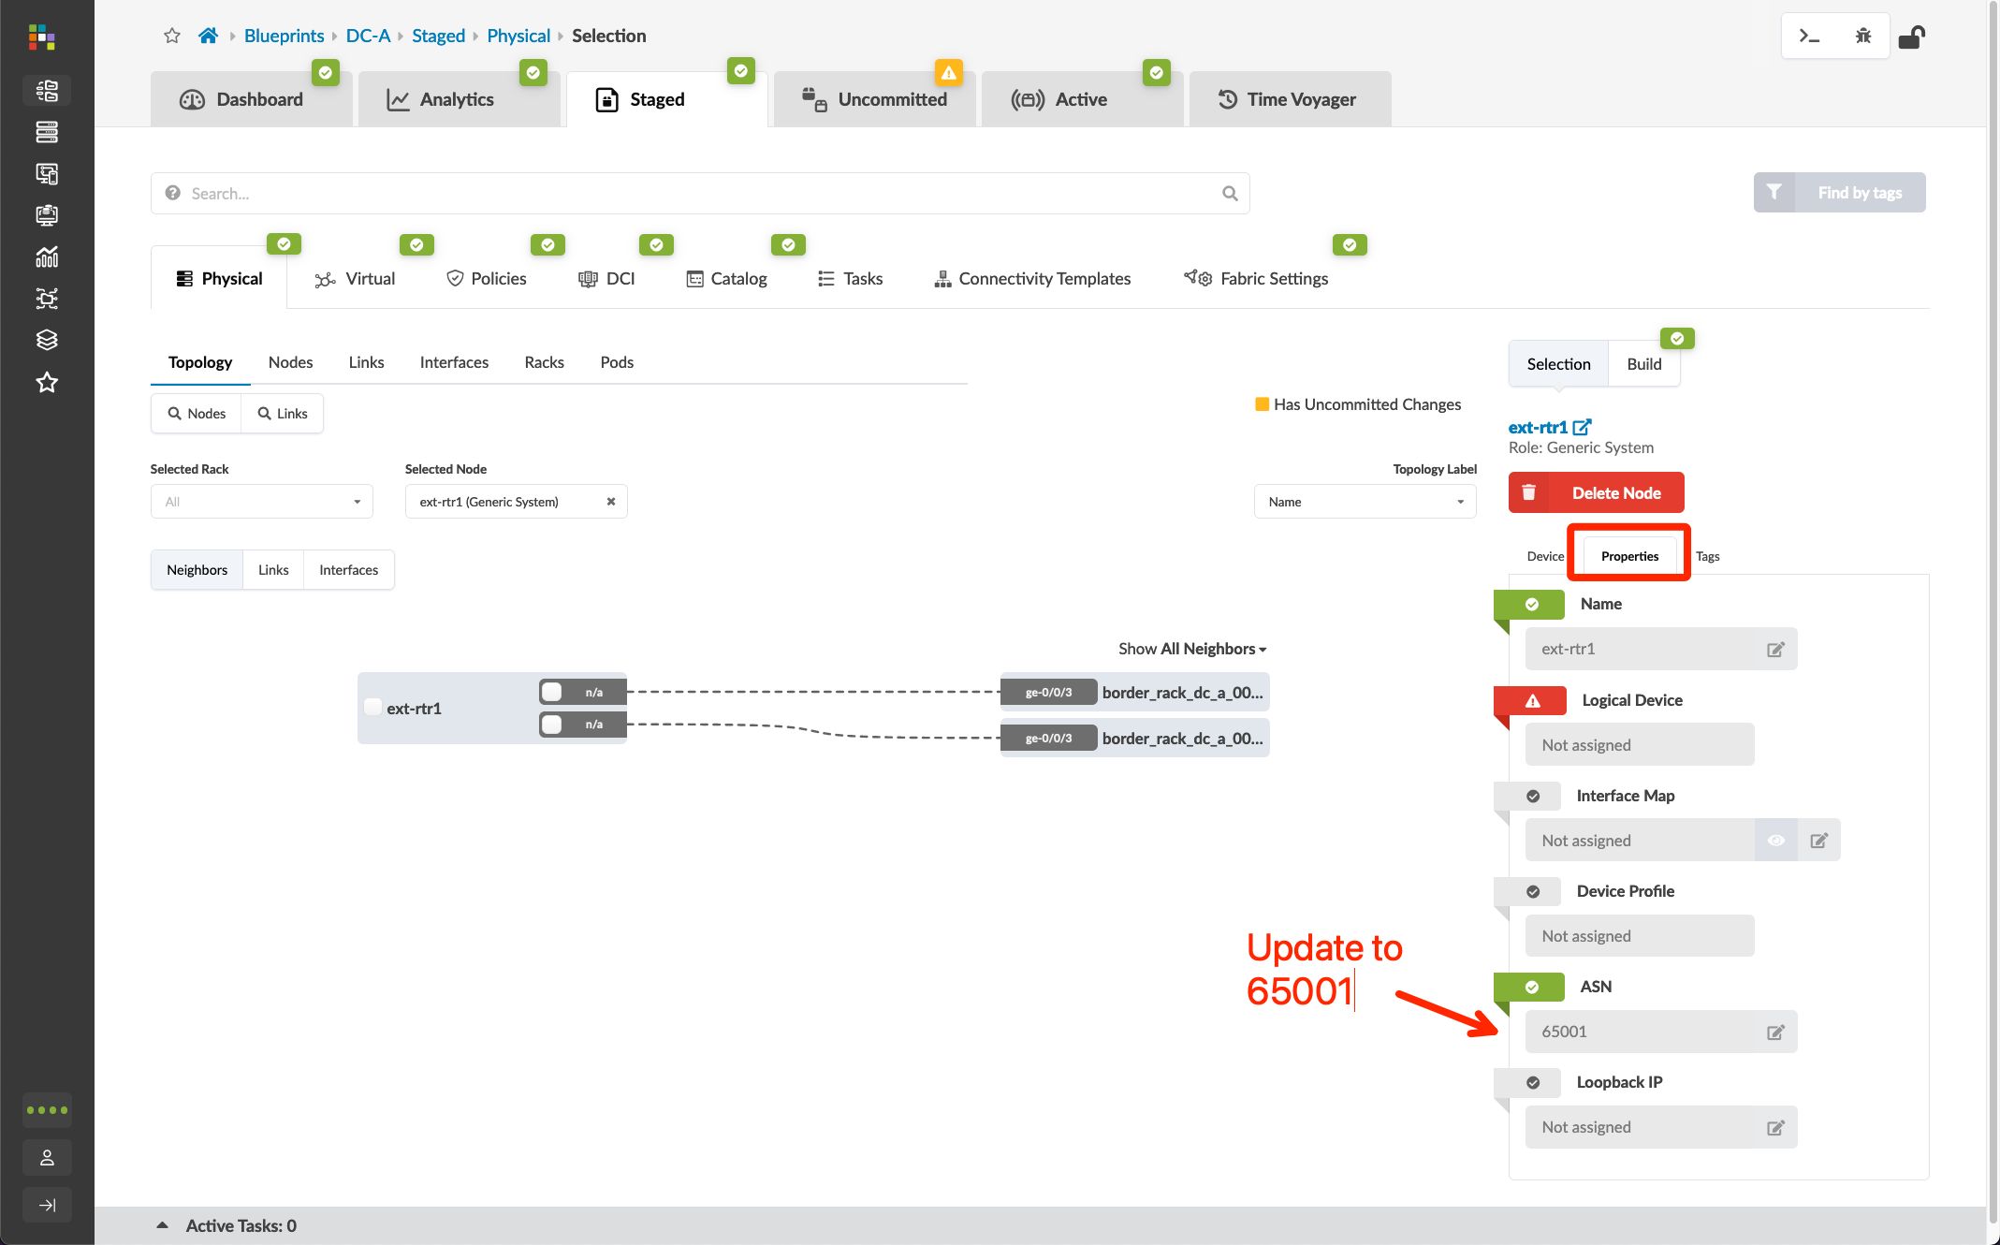
Data Center Interconnect #1 – Underlay
Go to Blueprints > DC-A > Staged > Physical > Topology and click “border_rack_dc_a_001_leaf1”
Click the checkbox for the border rack node and select “Add internal/external generic system”
Create a new external generic system called ext-rtr1, select “None” for the device representation, and click “Next”
Select port 3 on each border leaf, click the port icon followed by the “Add Link” button for each, then click “Create”
Click the "ext-router", open the properties page and edit its ASN, update it to 65001. If you skip this step, Apstra will ask you to assign a ASN resource pool to external generic system at later stage
Go to Blueprints > DC-A > Staged > Policies > Routing Policies, and click “Create Routing Policy”
Name: ext-router-policy
Import Policy: Extra Only
Extra Import Routes:
Export Policy: Loopbacks only
Prefix | GE Mask | LE Mask | Action
192.168.1.0/24 | 32 |  | Deny
0.0.0.0/0 | 32 |  | Permit

Slide 10
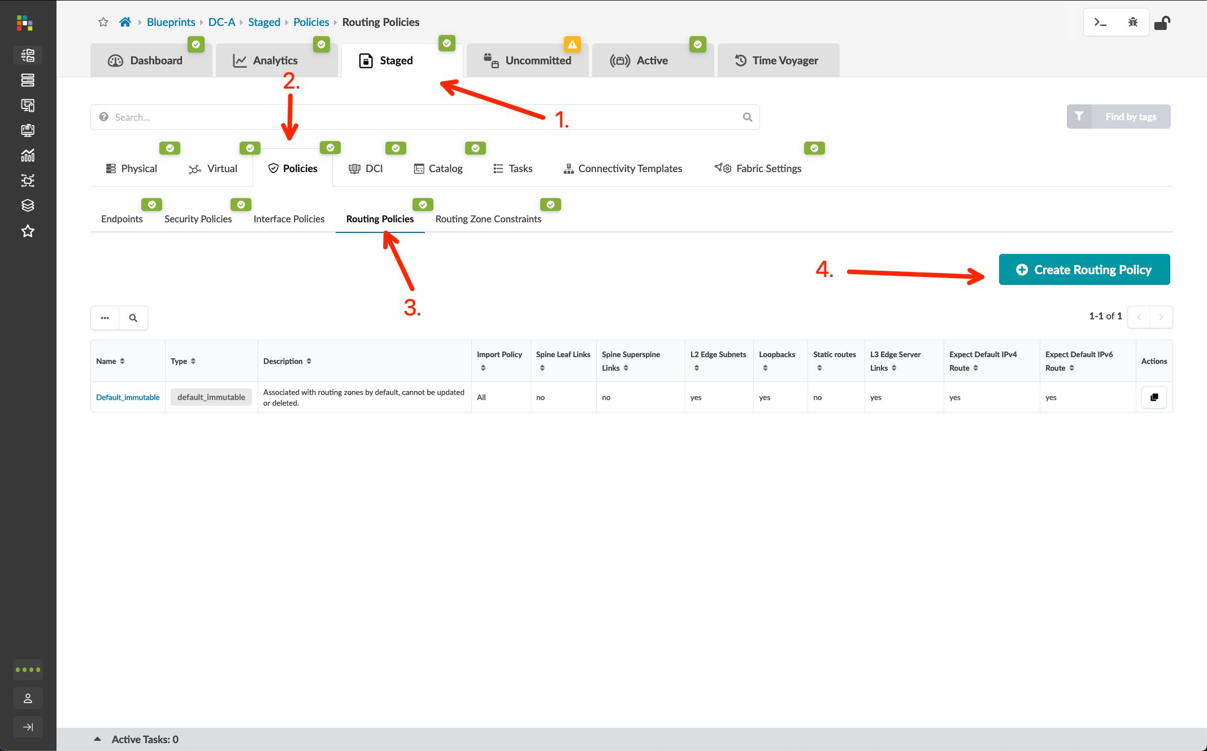
Data Center Interconnect #1 – Underlay
Go to Blueprints > DC-A > Staged > Physical > Topology and click “border_rack_dc_a_001_leaf1”
Click the checkbox for the border rack node and select “Add internal/external generic system”
Create a new external generic system called ext-rtr1, select “None” for the device representation, and click “Next”
Select port 3 on each border leaf, click the port icon followed by the “Add Link” button for each, then click “Create”
Click the "ext-router", open the properties page and edit its ASN, update it to 65001. If you skip this step, Apstra will ask you to assign a ASN resource pool to external generic system at later stage
Go to Blueprints > DC-A > Staged > Policies > Routing Policies, and click “Create Routing Policy”
Name: ext-router-policy
Import Policy: Extra Only
Extra Import Routes:
Export Policy: Loopbacks only
Prefix | GE Mask | LE Mask | Action
192.168.1.0/24 | 32 |  | Deny
0.0.0.0/0 | 32 |  | Permit

Slide 11
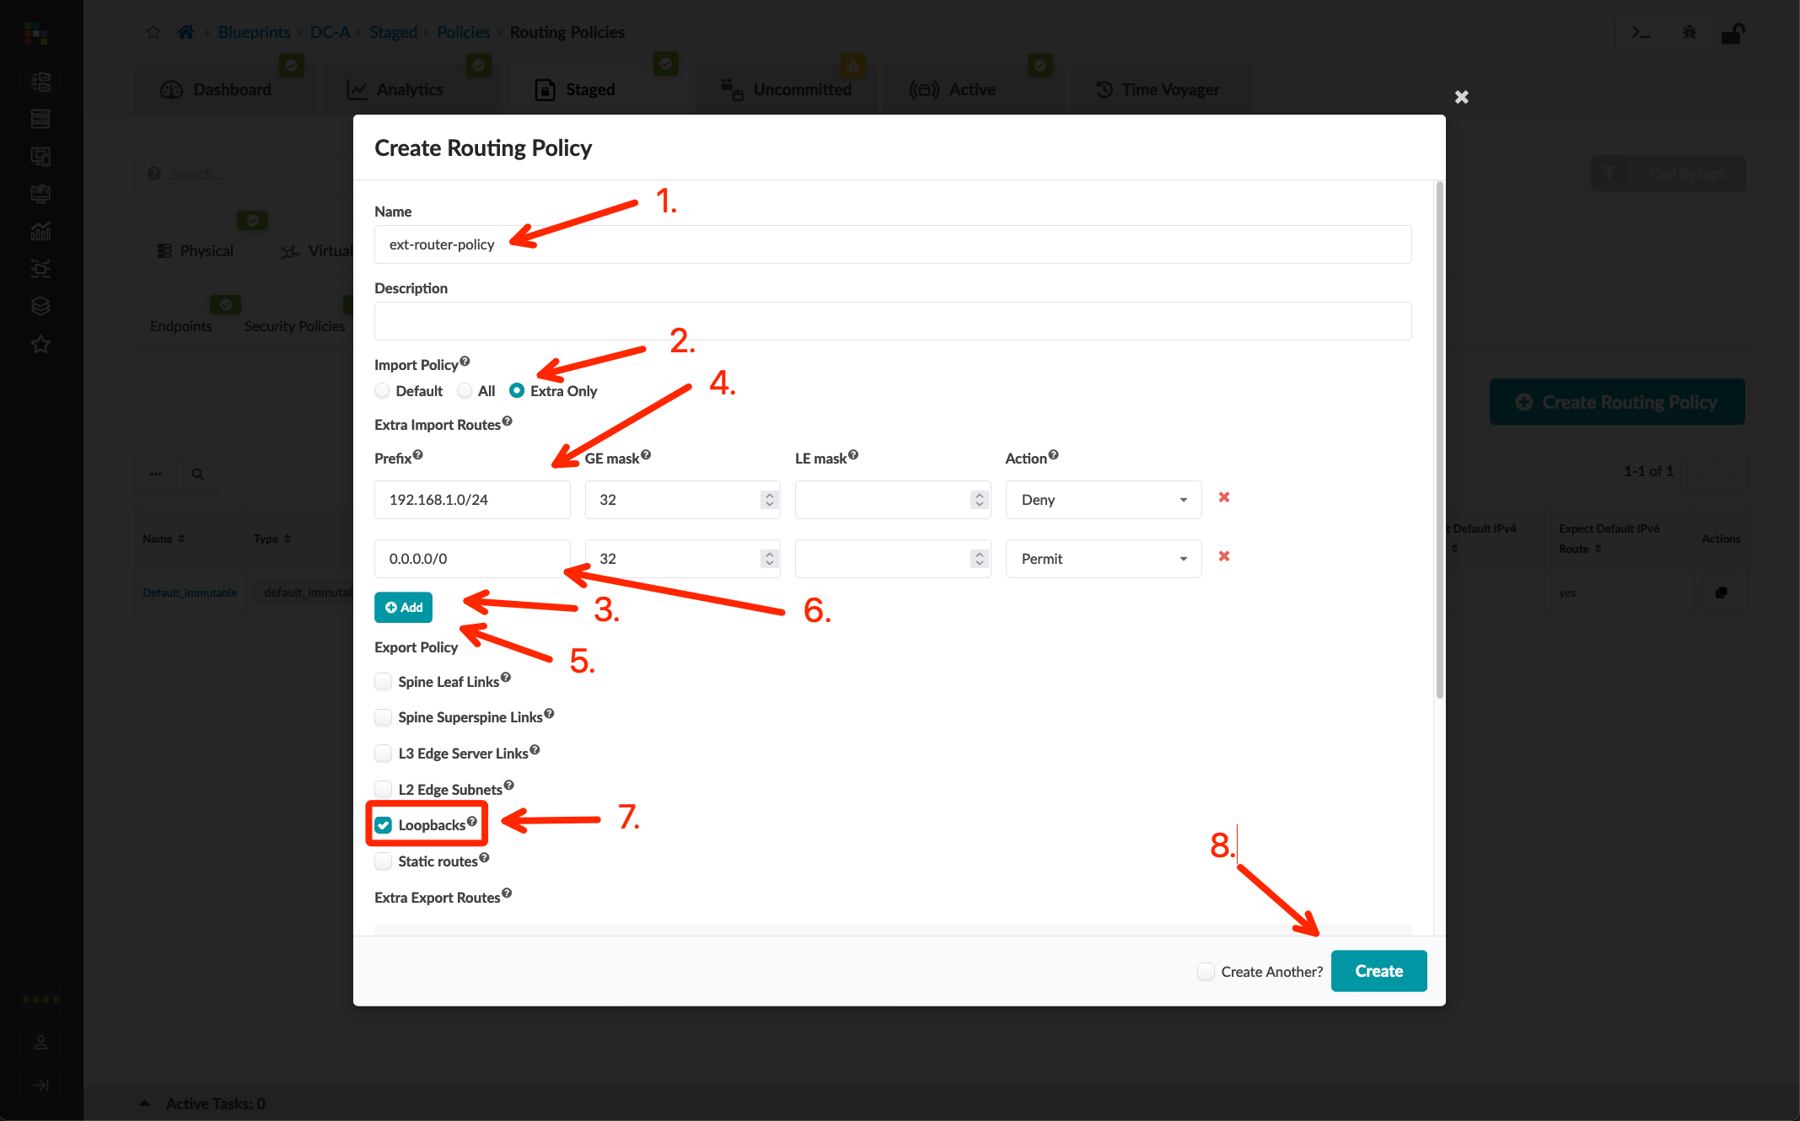
Data Center Interconnect #1 – Underlay
Go to Blueprints > DC-A > Staged > Physical > Topology and click “border_rack_dc_a_001_leaf1”
Click the checkbox for the border rack node and select “Add internal/external generic system”
Create a new external generic system called ext-rtr1, select “None” for the device representation, and click “Next”
Select port 3 on each border leaf, click the port icon followed by the “Add Link” button for each, then click “Create”
Click the "ext-router", open the properties page and edit its ASN, update it to 65001. If you skip this step, Apstra will ask you to assign a ASN resource pool to external generic system at later stage
Go to Blueprints > DC-A > Staged > Policies > Routing Policies, and click “Create Routing Policy”
Name: ext-router-policy
Import Policy: Extra Only
Extra Import Routes:
Export Policy: Loopbacks only
Prefix | GE Mask | LE Mask | Action
192.168.1.0/24 | 32 |  | Deny
0.0.0.0/0 | 32 |  | Permit

Slide 12
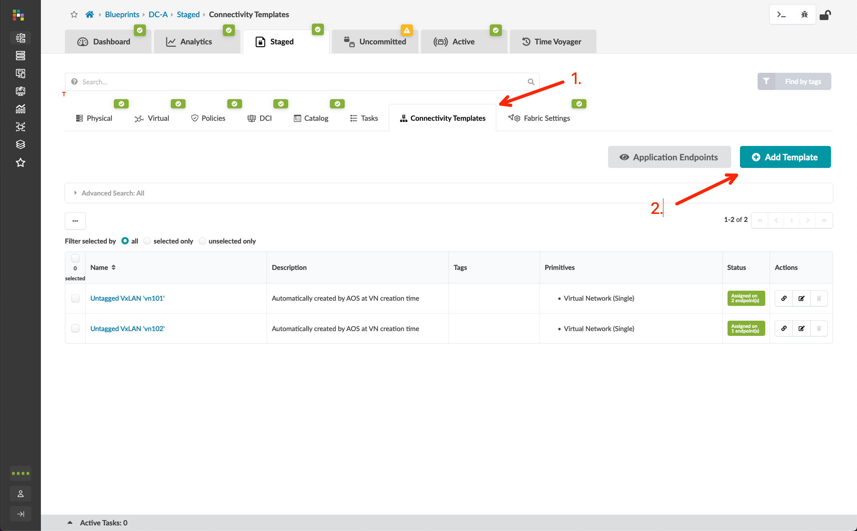
Data Center Interconnect #1 – Underlay
Go to Blueprints > DC-A > Staged > Connectivity Templates and create a new template called "ext-router-ct"
Follow the screenshots to create the connectivity template
Assign the connectivity template to the ge-0/0/3 interface of both border leaf switches
Go to Blueprints > DC-A > Staged > Physical, edit the Link IP’s – To Generic resource, and add the External Link IP Pool
Go to Blueprints > DC-A > Staged > Virtual > Protocol Sessions, get the ASN/IP address of border leaf switches and IP address of external router links

Slide 13
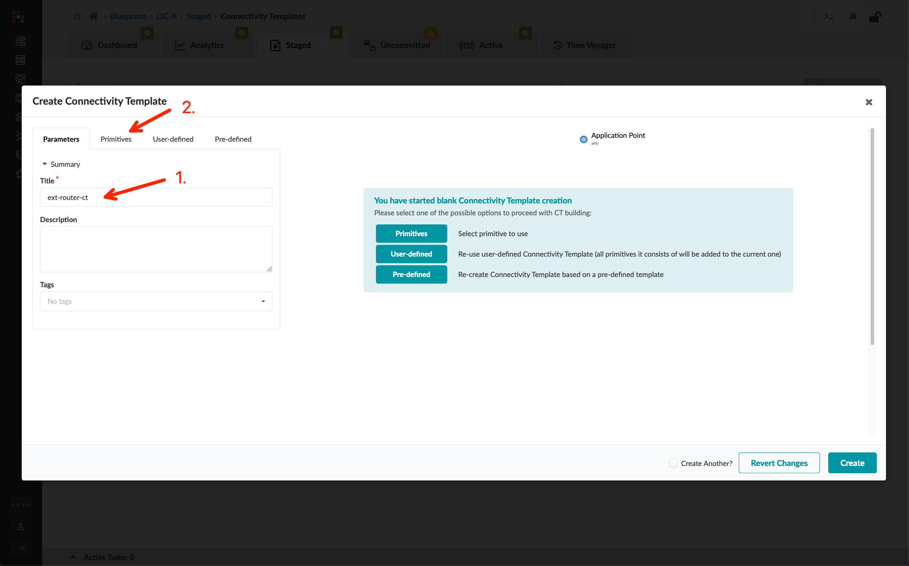
Data Center Interconnect #1 – Underlay
Go to Blueprints > DC-A > Staged > Connectivity Templates and create a new template called "ext-router-ct"
Follow the screenshots to create the connectivity template
Assign the connectivity template to the ge-0/0/3 interface of both border leaf switches
Go to Blueprints > DC-A > Staged > Physical, edit the Link IP’s – To Generic resource, and add the External Link IP Pool
Go to Blueprints > DC-A > Staged > Virtual > Protocol Sessions, get the ASN/IP address of border leaf switches and IP address of external router links

Slide 14
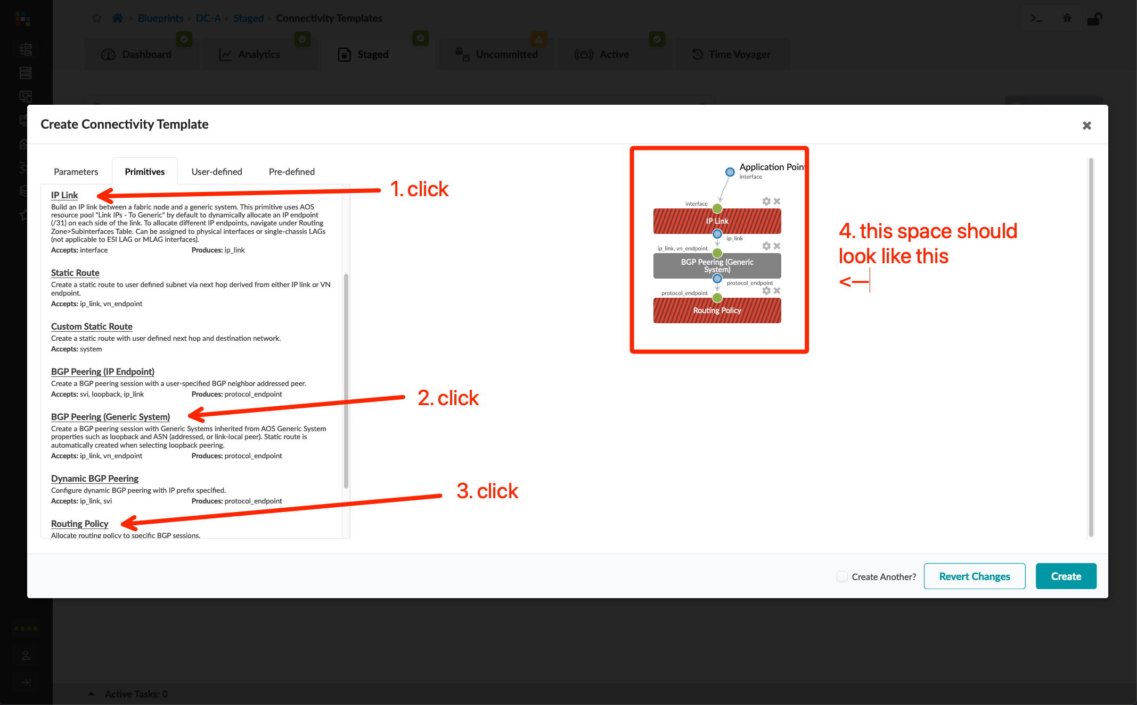
Data Center Interconnect #1 – Underlay
Go to Blueprints > DC-A > Staged > Connectivity Templates and create a new template called "ext-router-ct"
Follow the screenshots to create the connectivity template
Assign the connectivity template to the ge-0/0/3 interface of both border leaf switches
Go to Blueprints > DC-A > Staged > Physical, edit the Link IP’s – To Generic resource, and add the External Link IP Pool
Go to Blueprints > DC-A > Staged > Virtual > Protocol Sessions, get the ASN/IP address of border leaf switches and IP address of external router links

Slide 15
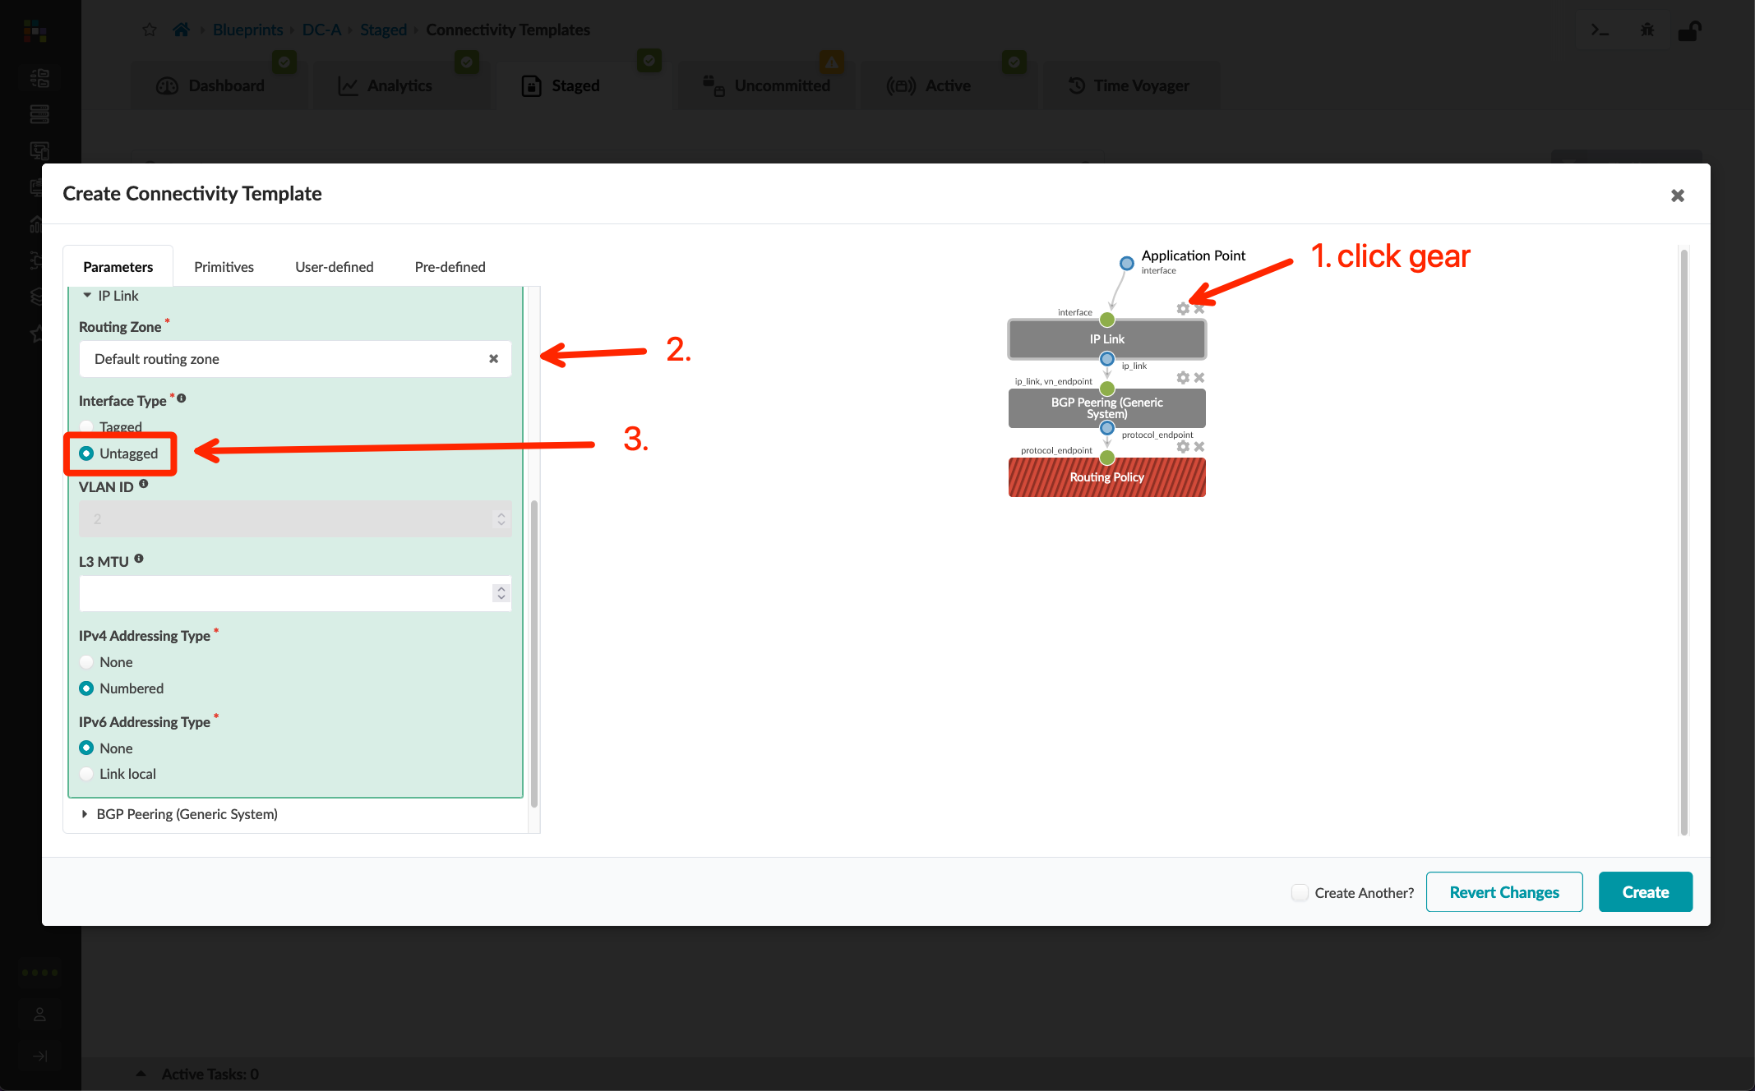
Data Center Interconnect #1 – Underlay
Go to Blueprints > DC-A > Staged > Connectivity Templates and create a new template called "ext-router-ct"
Follow the screenshots to create the connectivity template
Assign the connectivity template to the ge-0/0/3 interface of both border leaf switches
Go to Blueprints > DC-A > Staged > Physical, edit the Link IP’s – To Generic resource, and add the External Link IP Pool
Go to Blueprints > DC-A > Staged > Virtual > Protocol Sessions, get the ASN/IP address of border leaf switches and IP address of external router links

Slide 16
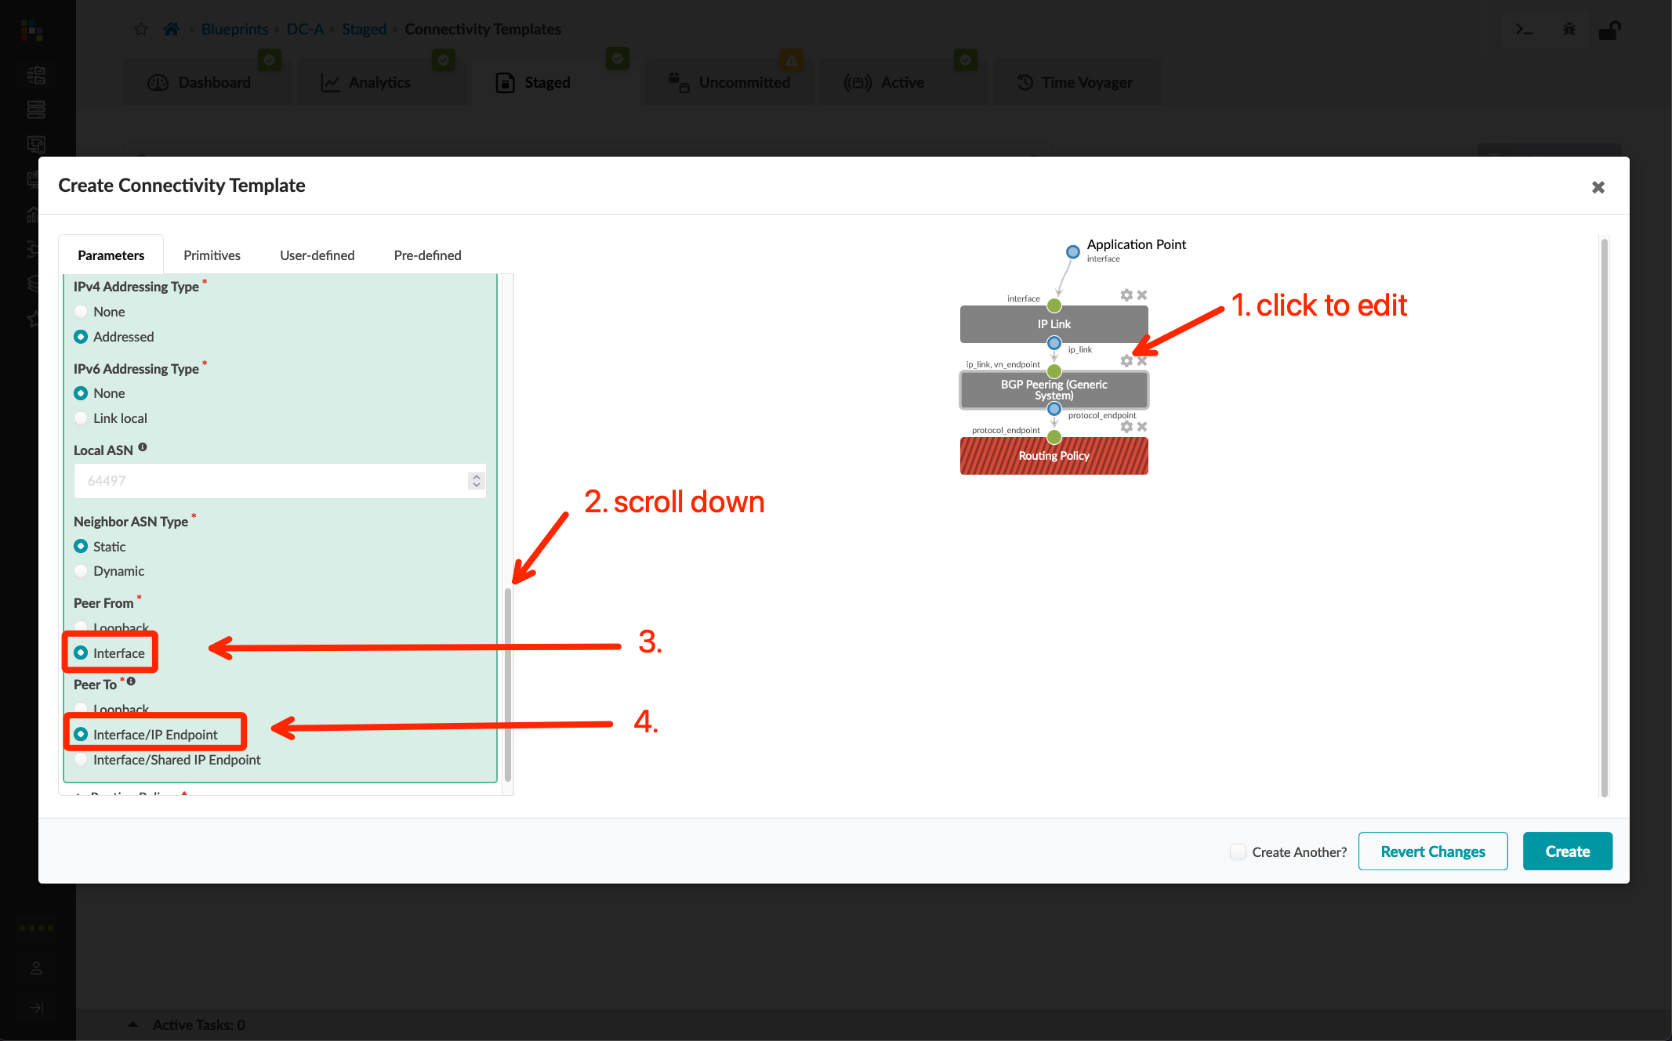
Data Center Interconnect #1 – Underlay
Go to Blueprints > DC-A > Staged > Connectivity Templates and create a new template called "ext-router-ct"
Follow the screenshots to create the connectivity template
Assign the connectivity template to the ge-0/0/3 interface of both border leaf switches
Go to Blueprints > DC-A > Staged > Physical, edit the Link IP’s – To Generic resource, and add the External Link IP Pool
Go to Blueprints > DC-A > Staged > Virtual > Protocol Sessions, get the ASN/IP address of border leaf switches and IP address of external router links

Slide 17
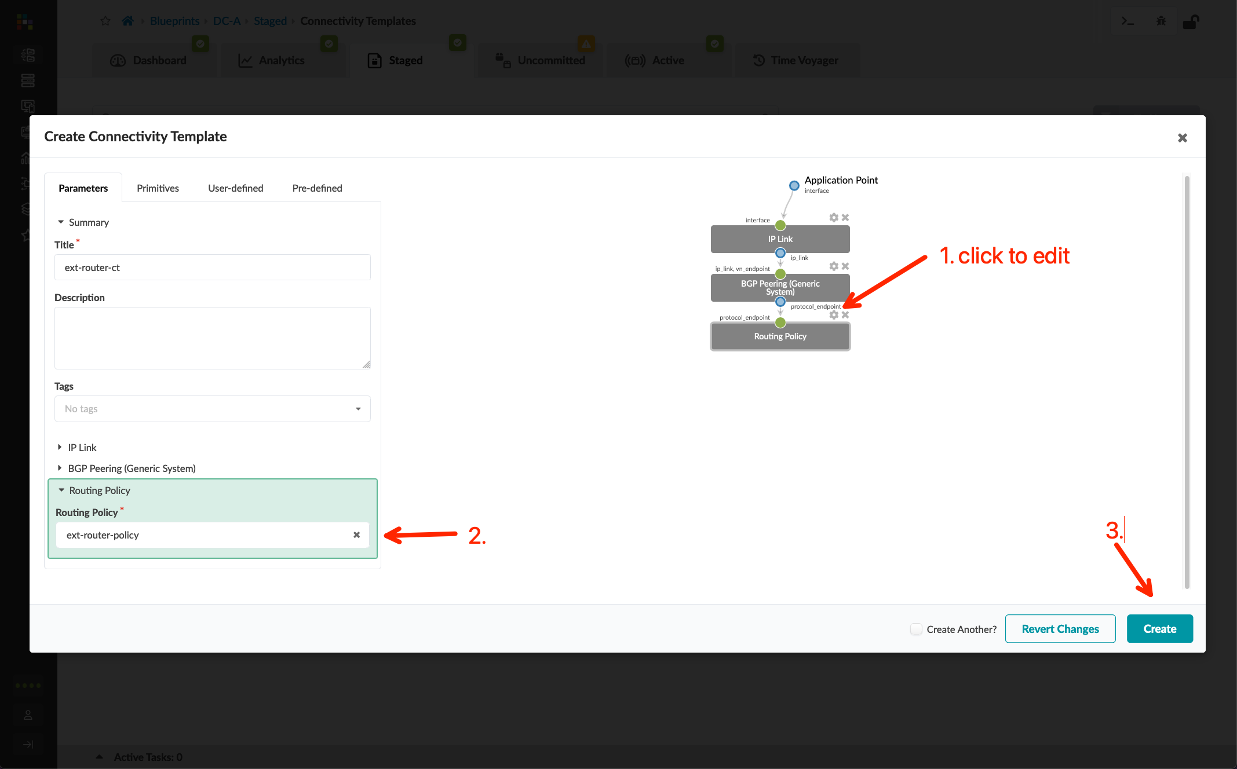
Data Center Interconnect #1 – Underlay
Go to Blueprints > DC-A > Staged > Connectivity Templates and create a new template called "ext-router-ct"
Follow the screenshots to create the connectivity template
Assign the connectivity template to the ge-0/0/3 interface of both border leaf switches
Go to Blueprints > DC-A > Staged > Physical, edit the Link IP’s – To Generic resource, and add the External Link IP Pool
Go to Blueprints > DC-A > Staged > Virtual > Protocol Sessions, get the ASN/IP address of border leaf switches and IP address of external router links

Slide 18
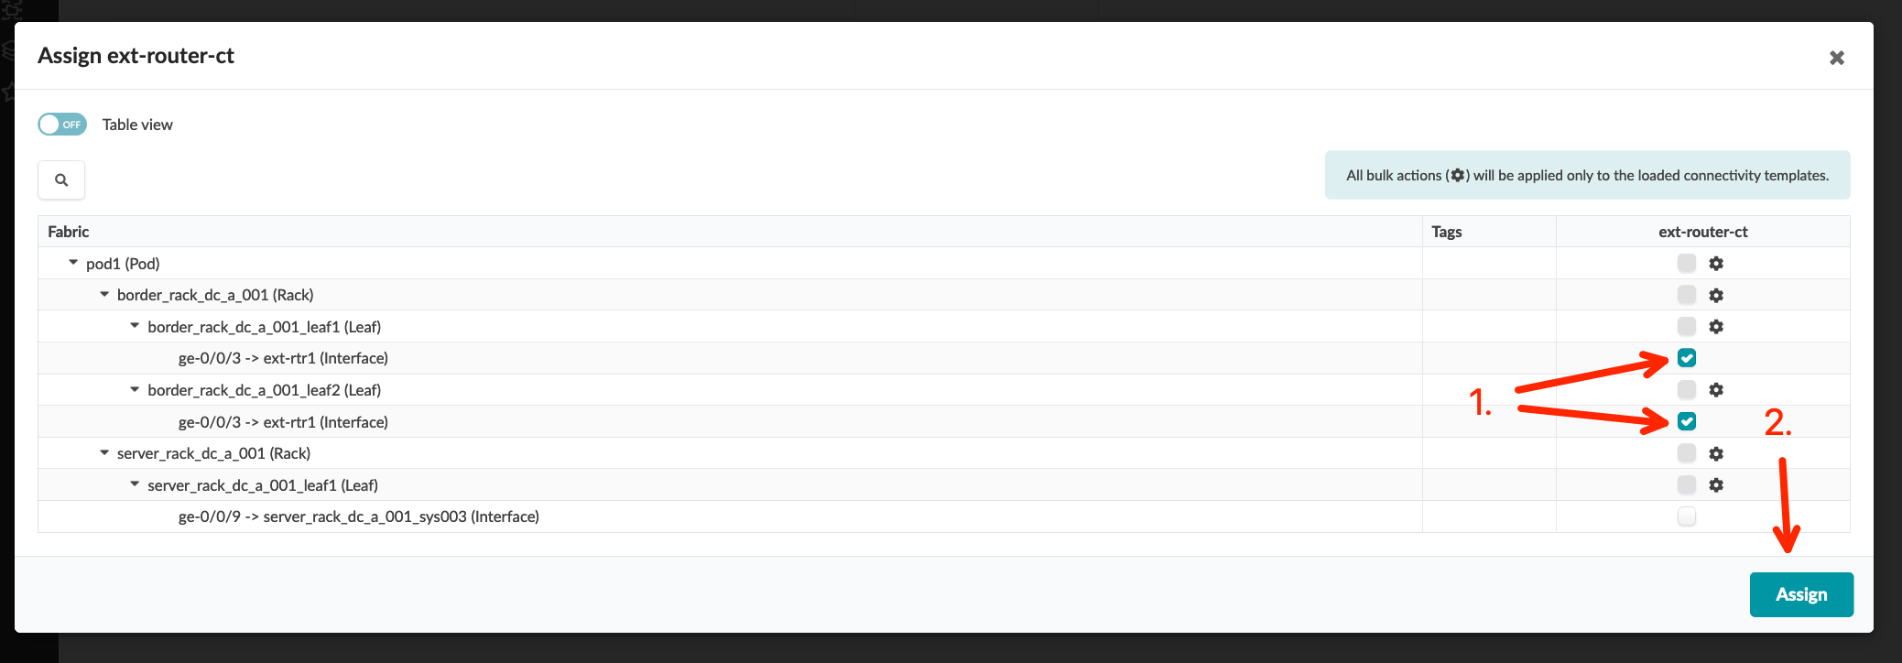
Data Center Interconnect #1 – Underlay
Go to Blueprints > DC-A > Staged > Connectivity Templates and create a new template called "ext-router-ct"
Follow the screenshots to create the connectivity template
Assign the connectivity template to the ge-0/0/3 interface of both border leaf switches
Go to Blueprints > DC-A > Staged > Physical, edit the Link IP’s – To Generic resource, and add the External Link IP Pool
Go to Blueprints > DC-A > Staged > Virtual > Protocol Sessions, get the ASN/IP address of border leaf switches and IP address of external router links

Slide 19
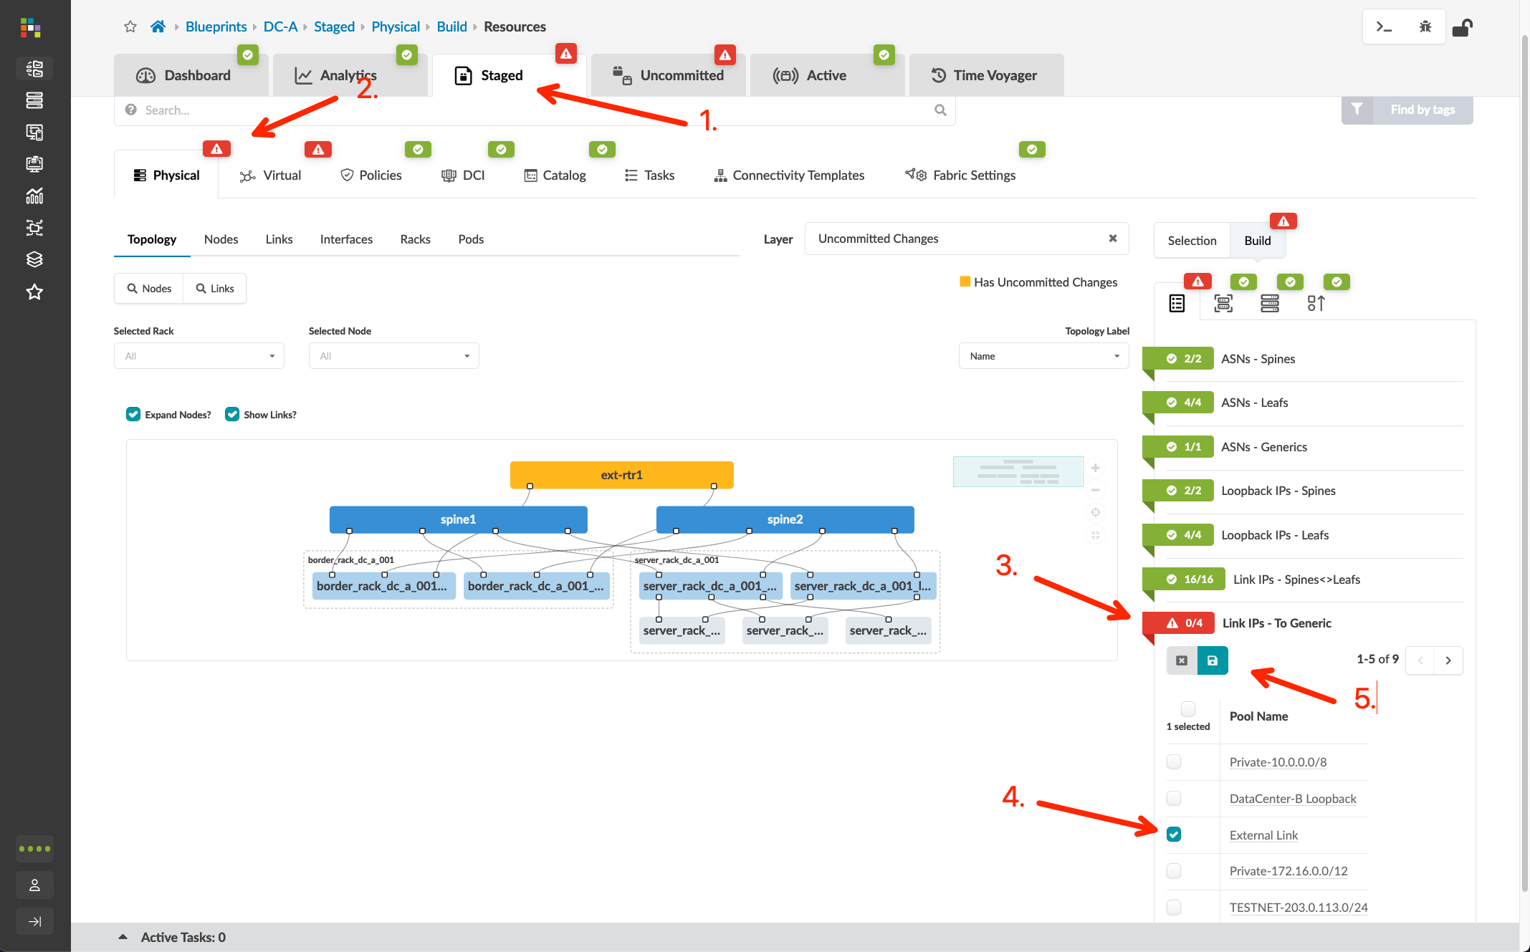
Data Center Interconnect #1 – Underlay
Go to Blueprints > DC-A > Staged > Connectivity Templates and create a new template called "ext-router-ct"
Follow the screenshots to create the connectivity template
Assign the connectivity template to the ge-0/0/3 interface of both border leaf switches
Go to Blueprints > DC-A > Staged > Physical, edit the Link IP’s – To Generic resource, and add the External Link IP Pool
Go to Blueprints > DC-A > Staged > Virtual > Protocol Sessions, get the ASN/IP address of border leaf switches and IP address of external router links

Slide 20
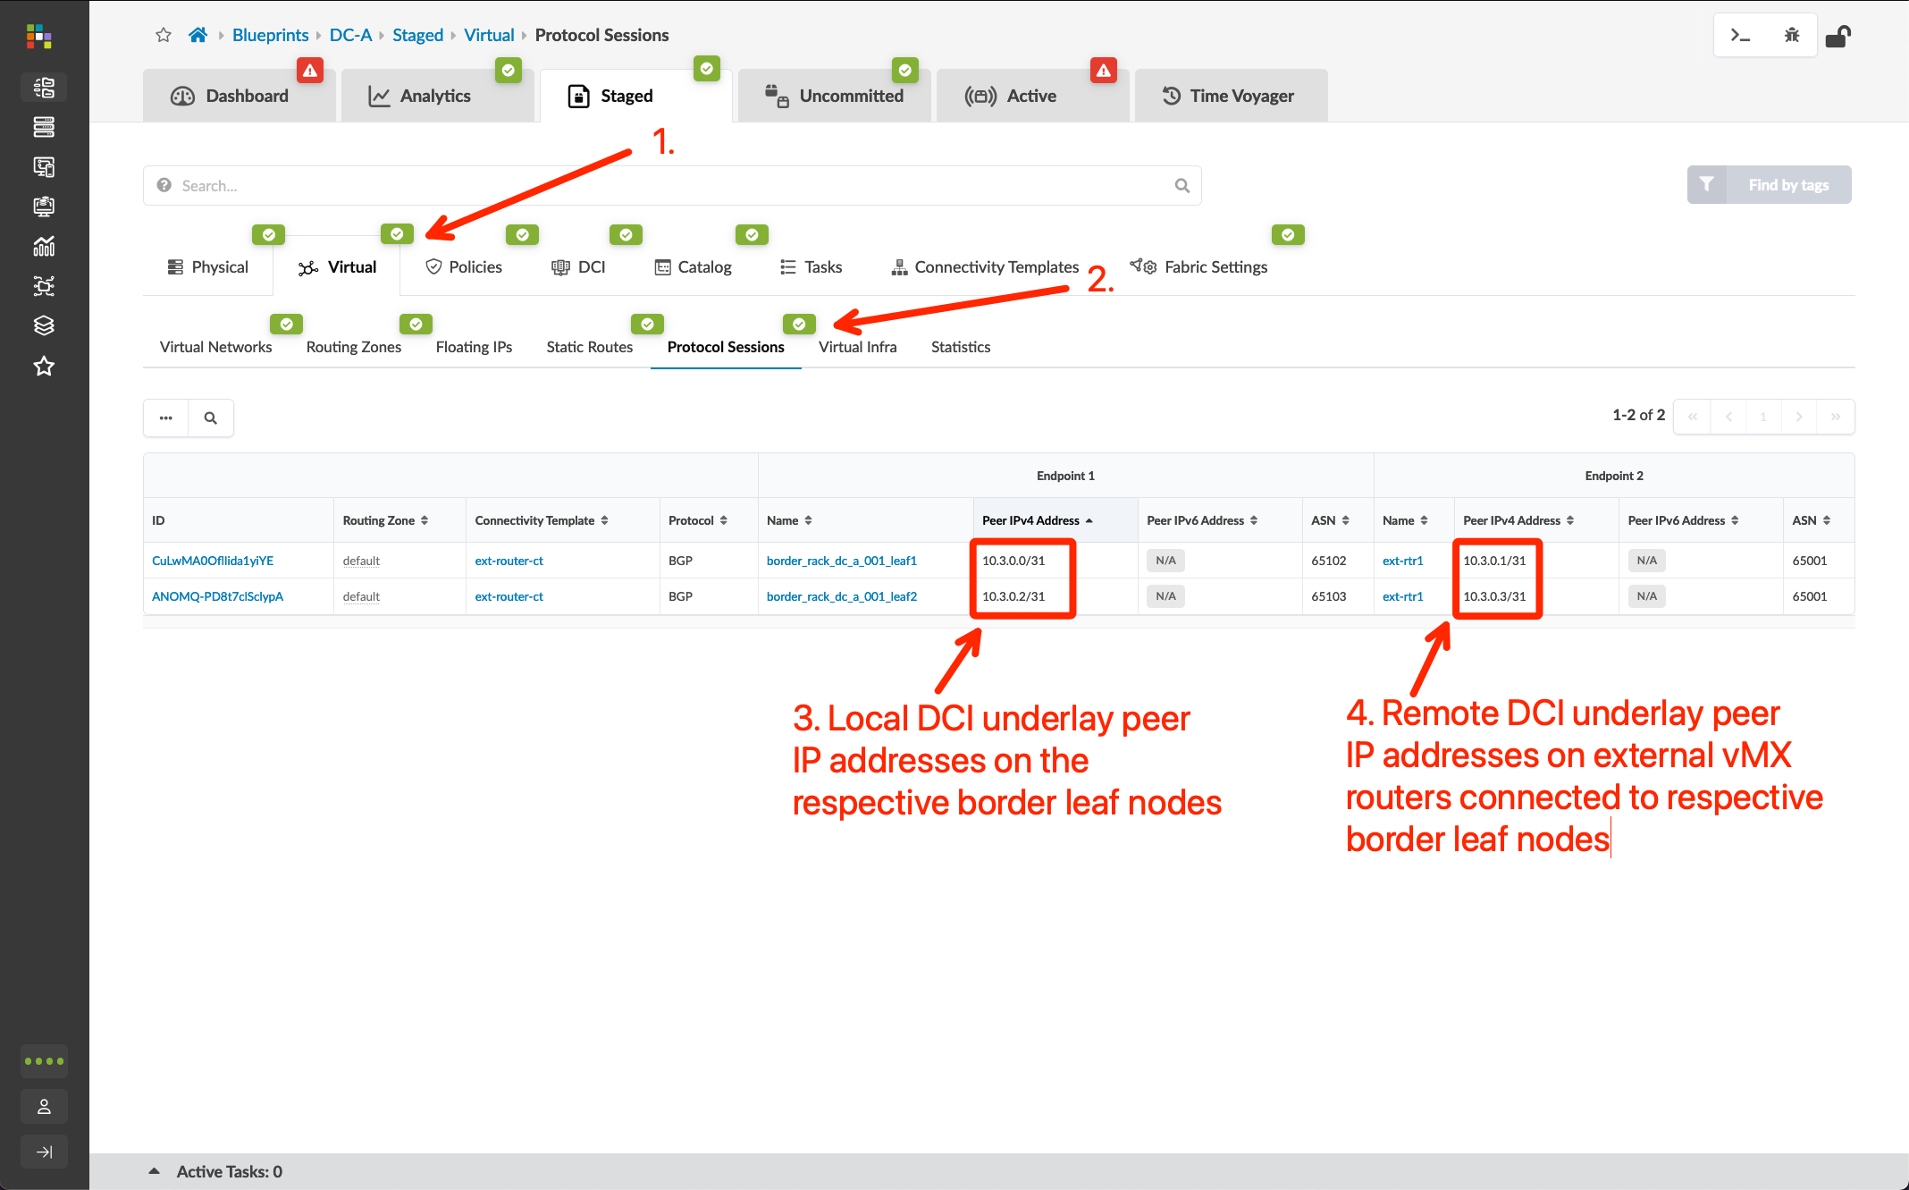
Data Center Interconnect #1 – Underlay
Go to Blueprints > DC-A > Staged > Connectivity Templates and create a new template called "ext-router-ct"
Follow the screenshots to create the connectivity template
Assign the connectivity template to the ge-0/0/3 interface of both border leaf switches
Go to Blueprints > DC-A > Staged > Physical, edit the Link IP’s – To Generic resource, and add the External Link IP Pool
Go to Blueprints > DC-A > Staged > Virtual > Protocol Sessions, get the ASN/IP address of border leaf switches and IP address of external router links

Slide 21
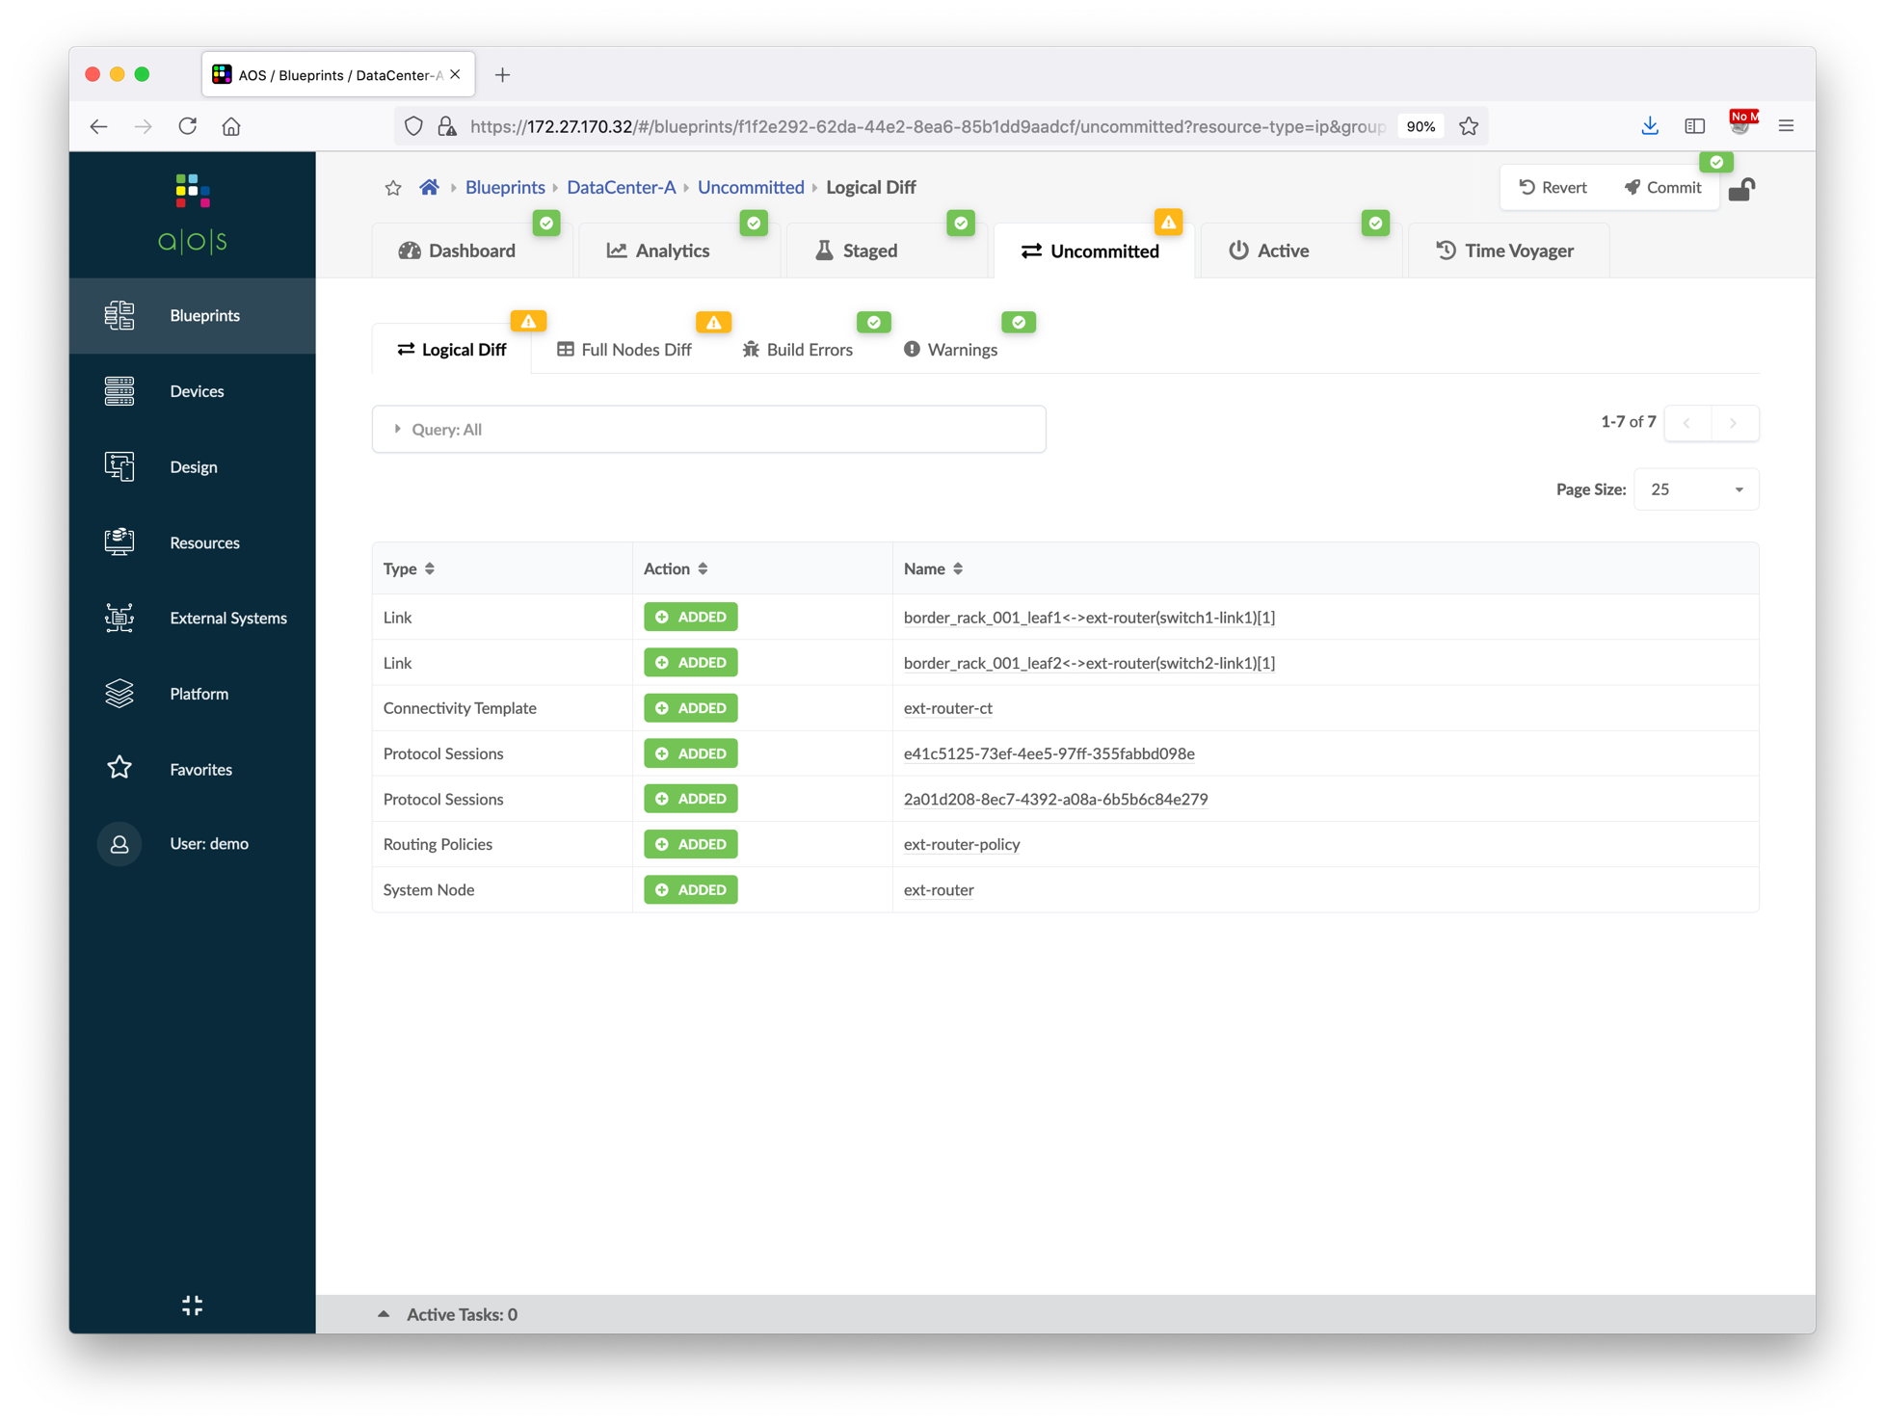
Data Center Interconnect #1 – Underlay
Commit the Blueprint for DC-A
Repeat the steps for DC-B:
create an external generic system ext-rtr2
add two links connecting to ge-0/0/3 of border1 and border2
assign ASN 65002 to the external router
create routing policy ext-router-policy (Import “Extra Only”, deny 192.168.2.0/24 GE 32, permit 0.0.0.0/0 GE 32, export only loopbacks)
create connectivity template ext-router-ct
assign the connectivity template to ge-0/0/3 of border1 and border2
assign External Link IP address pool to generic systems
get the ASN and IP address of border leaf switches and external router
①
②

Slide 22
Data Center Interconnect #1 – Underlay
Login to ext-rtr1 and ext-rtr2, and then apply interface and routing configuration to establish underlay BGP connectivity to EVPN fabric
ext-rtr1 configuration
set system root-authentication plain-text-password (Juniper)
set system host-name ext-rtr1
delete chassis
set interfaces lo0.0 family inet address 172.31.0.0/32
set interfaces ge-0/0/0.0 family inet address 10.100.100.0/31
set interfaces ge-0/0/1.0 family inet address 10.3.0.1/31
set interfaces ge-0/0/2.0 family inet address 10.3.0.3/31
set routing-options autonomous-system 65001
set protocols bgp group DCI neighbor 10.100.100.1 peer-as 65002
set protocols bgp group ebgp neighbor 10.3.0.0 peer-as 65102
set protocols bgp group ebgp neighbor 10.3.0.2 peer-as 65103
(set local root password)
(set local hostname)
(stop auto-configure script)
(set local loopback address)
(interface to ext-rtr2)
(interface to A-border1)
(interface to A-border2)
(local ASN)
(BGP neighbor to ext-rtr2)
(BGP neighbor to A-border1)
(BGP neighbor to A-border2)

Slide 23
Data Center Interconnect #1 – Underlay
Login to ext-rtr1 and ext-rtr2, and then apply interface and routing configuration to establish underlay BGP connectivity to EVPN fabric
ext-rtr2 configuration
Login to Spine, Border Leaf, and Leaf switches to verify the route table, you should be able to see the loopback address routes from another data center
set system root-authentication plain-text-password (Juniper)
set system host-name ext-rtr2
delete chassis
set interfaces lo0.0 family inet address 172.31.0.1/32
set interfaces ge-0/0/0.0 family inet address 10.100.100.1/31
set interfaces ge-0/0/1.0 family inet address 10.3.0.5/31
set interfaces ge-0/0/2.0 family inet address 10.3.0.7/31
set routing-options autonomous-system 65002
set protocols bgp group DCI neighbor 10.100.100.0 peer-as 65001
set protocols bgp group ebgp neighbor 10.3.0.4 peer-as 65202
set protocols bgp group ebgp neighbor 10.3.0.6 peer-as 65203
(set local root password)
(set local hostname)
(stop auto-configure script)
(set local loopback address)
(interface to ext-rtr1)
(interface to B-border1)
(interface to B-border2)
(local ASN)
(BGP neighbor to ext-rtr1)
(BGP neighbor to B-border1)
(BGP neighbor to B-border2)

Slide 24
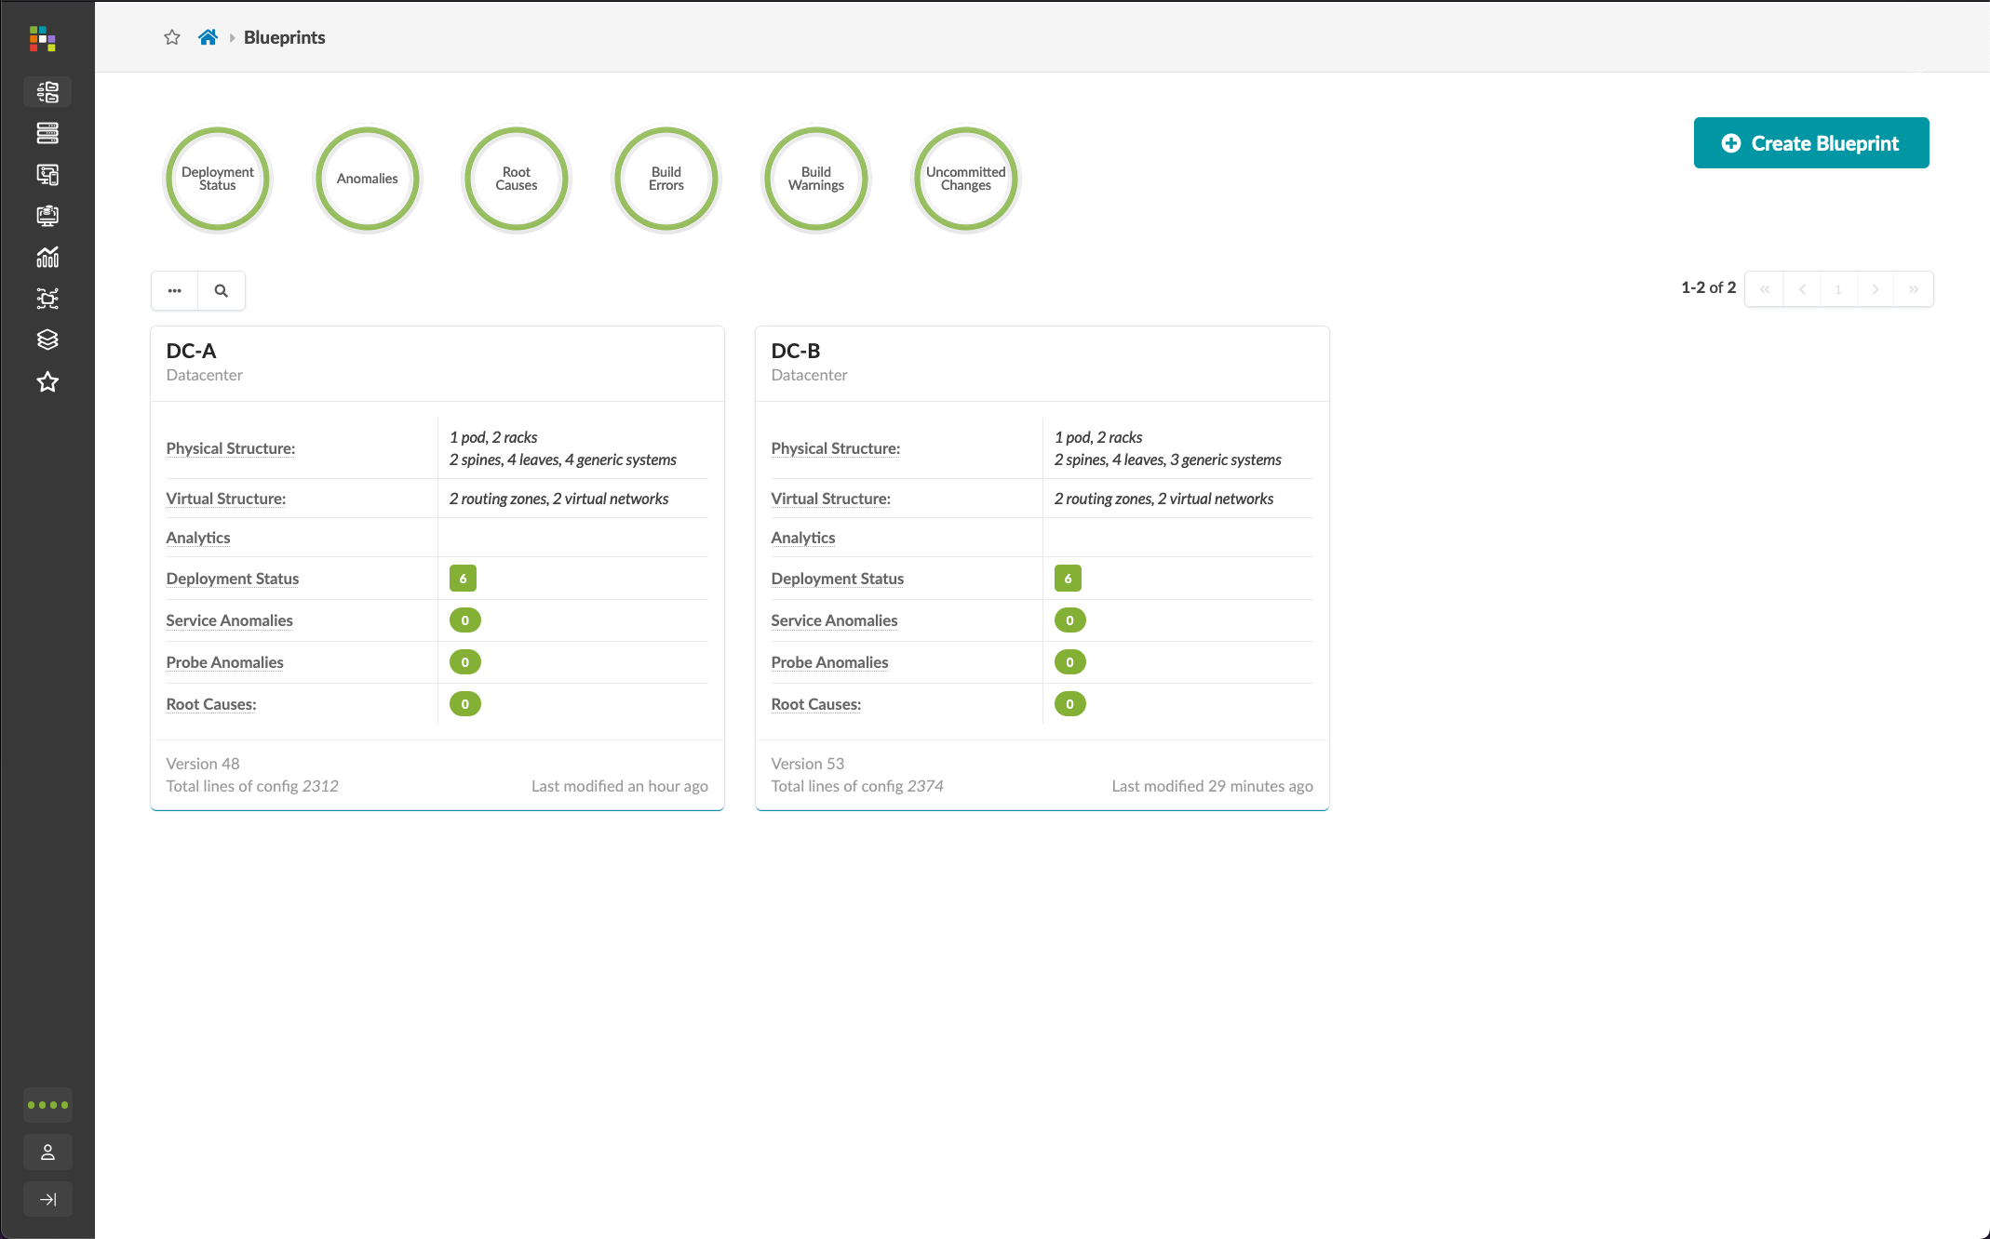
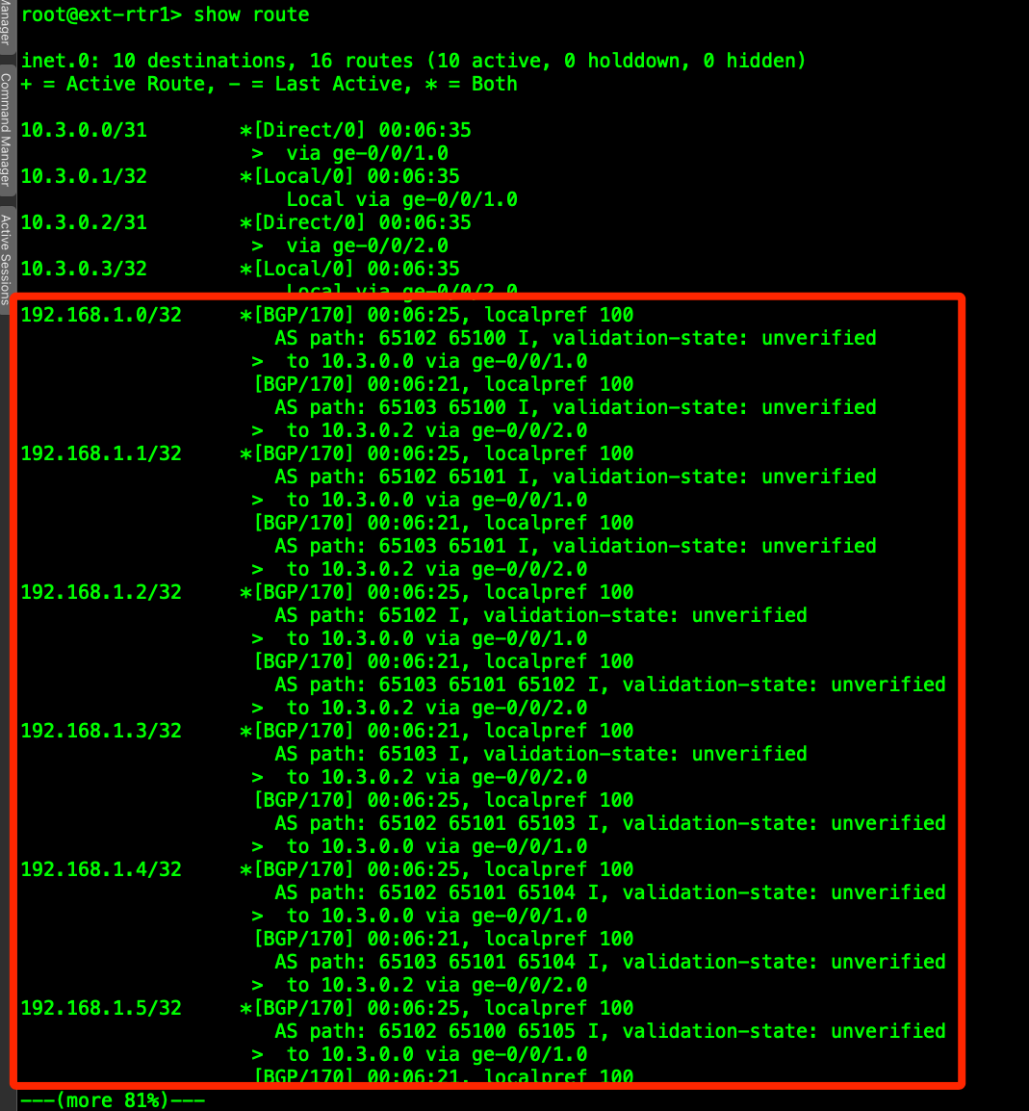
Data Center Interconnect #1 – Underlay

Slide 25
Data Center Interconnect #2 – Overlay
After exchanging the loopback addresses between data centers, we will create a remote EVPN gateway in each blueprint to establish the EVPN BGP sessions between border leaf switches.
The below diagram illustrates the topology of the data center after this section.
ext-rtr1
ext-rtr2
OTT EVPN BGP sessions created in this section to exchange EVPN routes
A-border1
A-border2
B-border1
B-border2
A-spine1
A-spine2
B-spine1
B-spine2
A-leaf1
A-leaf2
B-leaf1
B-leaf2

Slide 26
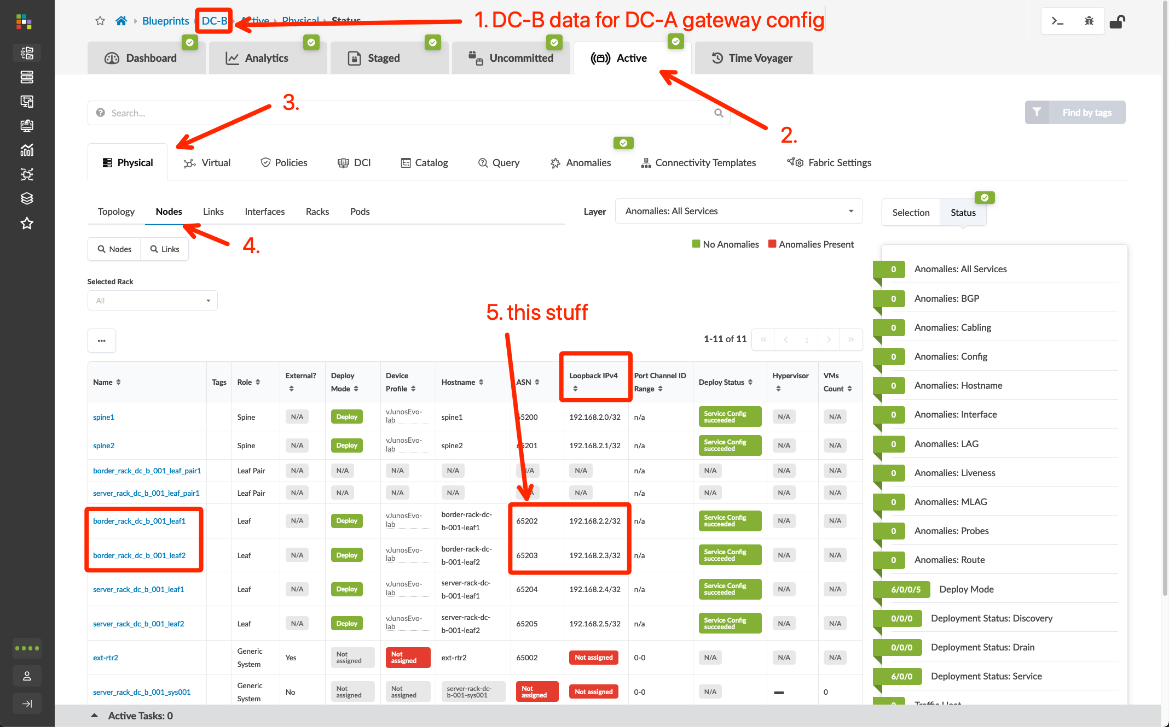
Data Center Interconnect #2 – Overlay
Go to Blueprints > DC-B > Active > Physical > Nodes and note the Loopback IP’s and ASN’s for the border leaf switches
Go to Blueprints > DC-A > Staged > DCI > Over the Top or External Gateways, click “Create Over the Top or External Gateway” button, then define the border leaf switches in DC-B as the remote EVPN gateways using the following table
Commit the Blueprint
Name | IP Address | ASN | Local Gateway
B-border1 | 192.168.2.2 | 65202 | border_rack_dc-a-001_leaf1
B-border2 | 192.168.2.3 | 65203 | border_rack_dc-a-001_leaf2
Repeat for DC-B by recording DC-A’s loopback and ASN assignments

Slide 27
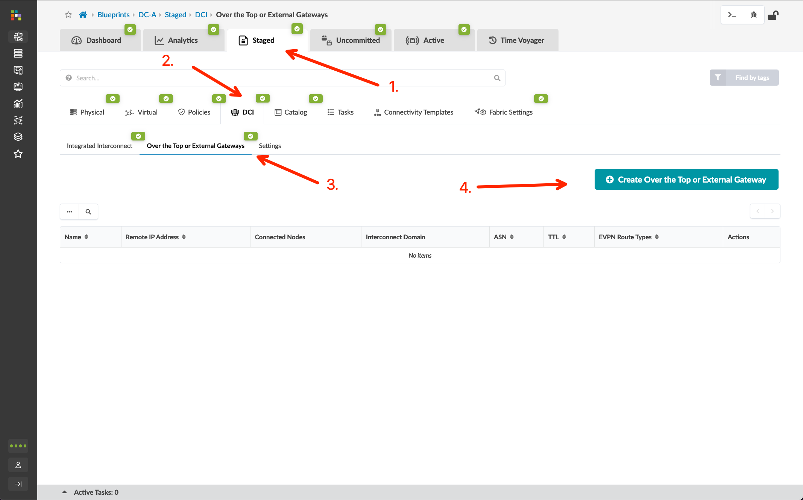
Data Center Interconnect #2 – Overlay
Go to Blueprints > DC-B > Active > Physical > Nodes and note the Loopback IP’s and ASN’s for the border leaf switches
Go to Blueprints > DC-A > Staged > DCI > Over the Top or External Gateways, click “Create Over the Top or External Gateway” button, then define the border leaf switches in DC-B as the remote EVPN gateways using the following table
Commit the Blueprint
Name | IP Address | ASN | Local Gateway
B-border1 | 192.168.2.2 | 65202 | border_rack_dc-a-001_leaf1
B-border2 | 192.168.2.3 | 65203 | border_rack_dc-a-001_leaf2

Slide 28
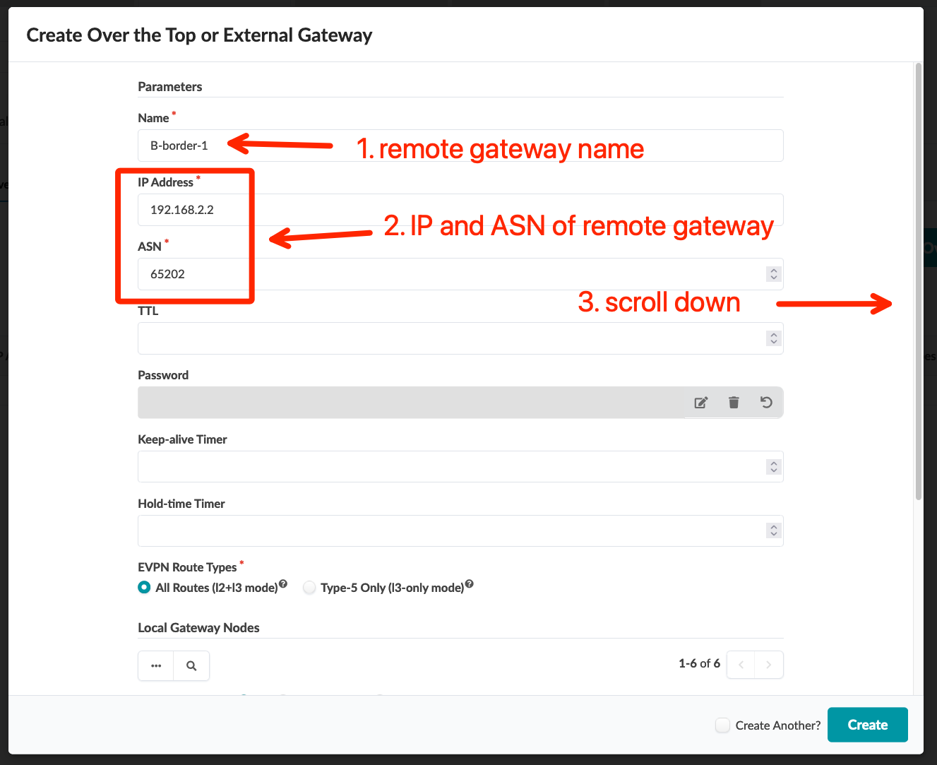
Data Center Interconnect #2 – Overlay
Go to Blueprints > DC-B > Active > Physical > Nodes and note the Loopback IP’s and ASN’s for the border leaf switches
Go to Blueprints > DC-A > Staged > DCI > Over the Top or External Gateways, click “Create Over the Top or External Gateway” button, then define the border leaf switches in DC-B as the remote EVPN gateways using the following table
Commit the Blueprint
Name | IP Address | ASN | Local Gateway
B-border1 | 192.168.2.2 | 65202 | border_rack_dc-a-001_leaf1
B-border2 | 192.168.2.3 | 65203 | border_rack_dc-a-001_leaf2

Slide 29
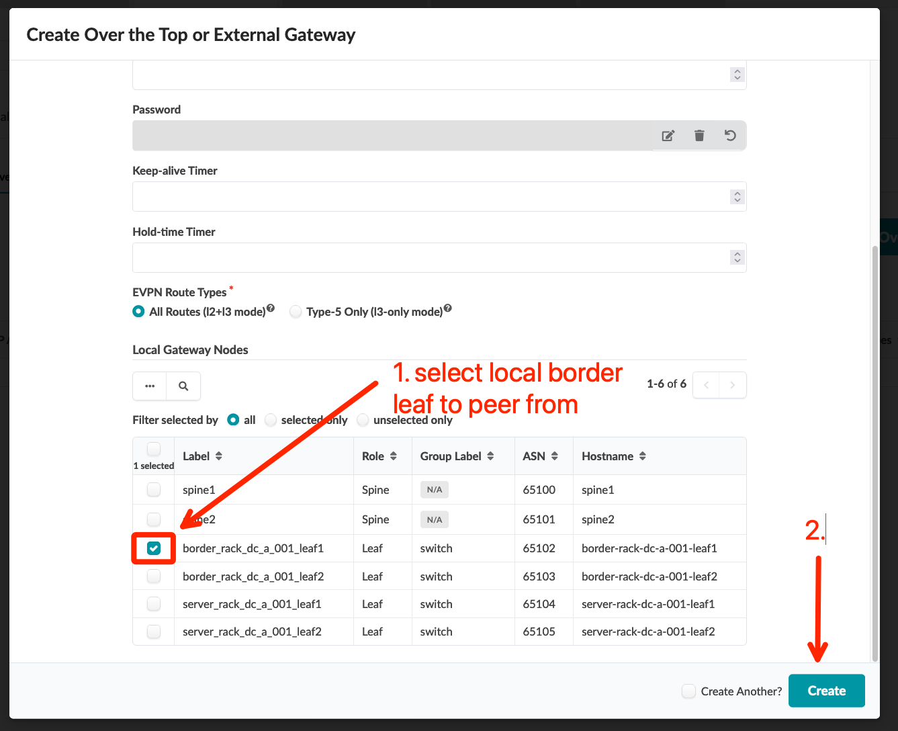
Data Center Interconnect #2 – Overlay
Go to Blueprints > DC-B > Active > Physical > Nodes and note the Loopback IP’s and ASN’s for the border leaf switches
Go to Blueprints > DC-A > Staged > DCI > Over the Top or External Gateways, click “Create Over the Top or External Gateway” button, then define the border leaf switches in DC-B as the remote EVPN gateways using the following table
Commit the Blueprint
Name | IP Address | ASN | Local Gateway
B-border1 | 192.168.2.2 | 65202 | border_rack_dc-a-001_leaf1
B-border2 | 192.168.2.3 | 65203 | border_rack_dc-a-001_leaf2

Slide 30
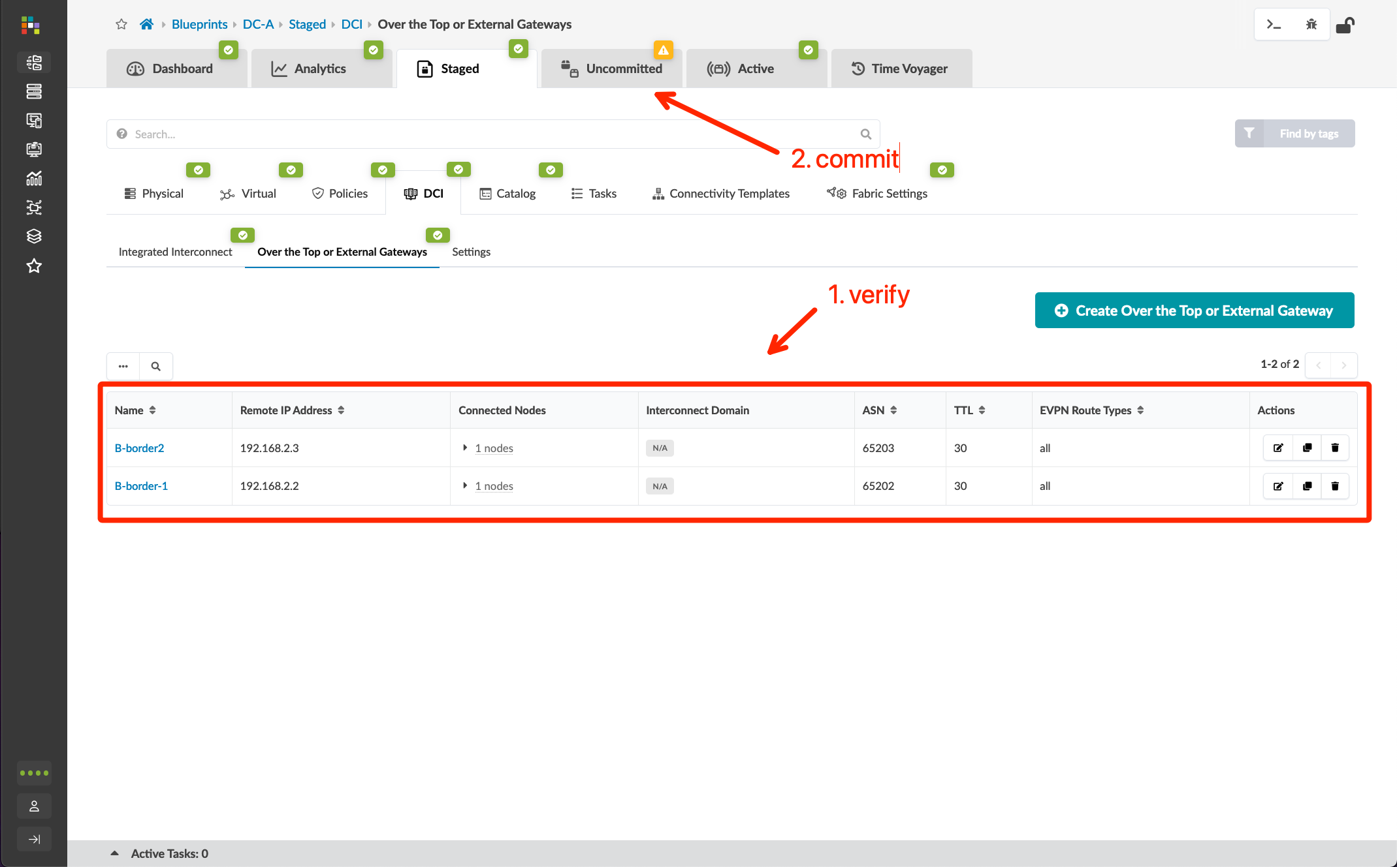
Data Center Interconnect #2 – Overlay
Go to Blueprints > DC-B > Active > Physical > Nodes and note the Loopback IP’s and ASN’s for the border leaf switches
Go to Blueprints > DC-A > Staged > DCI > Over the Top or External Gateways, click “Create Over the Top or External Gateway” button, then define the border leaf switches in DC-B as the remote EVPN gateways using the following table
Commit the Blueprint
Name | IP Address | ASN | Local Gateway
B-border1 | 192.168.2.2 | 65202 | border_rack_dc-a-001_leaf1
B-border2 | 192.168.2.3 | 65203 | border_rack_dc-a-001_leaf2

Slide 31
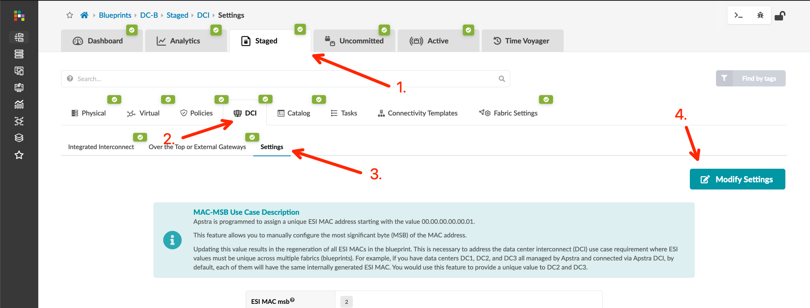
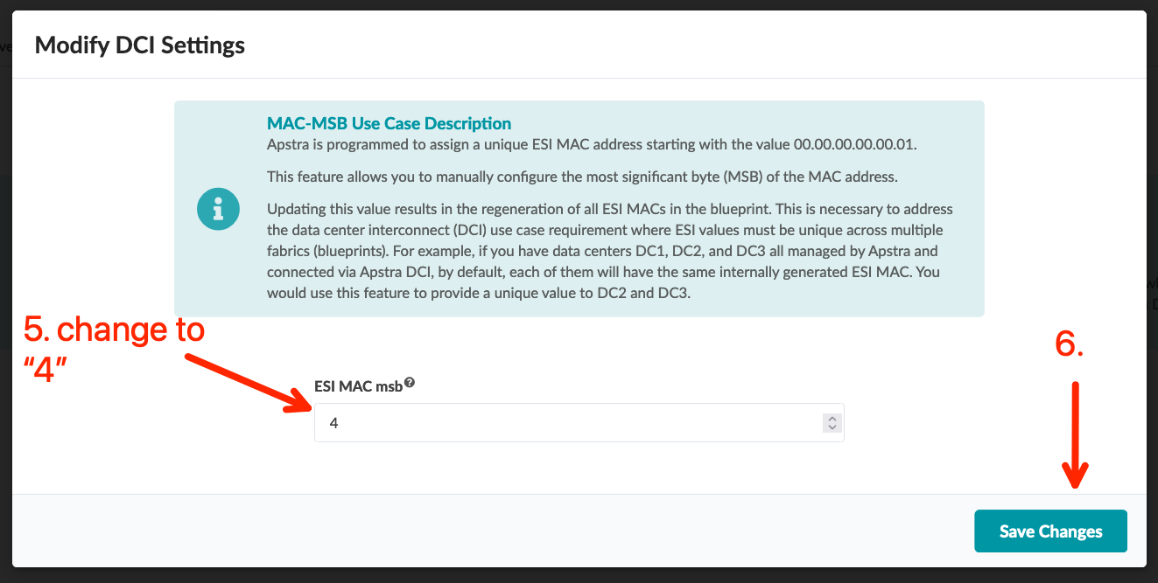
Data Center Interconnect #2 – Overlay
Go to Blueprints > DC-B > Staged > DCI > Settings, click “Modify Settings” button, and change the ESI MAC msb value from 2 to 4
Go to Blueprints > DC-B > Staged > DCI > Over the Top or External Gateways and create EVPN BGP sessions between the local border leafs and the border leafs in DC-A
Commit the Blueprint
Name | IP Address | ASN | Local Gateway
A-border1 | 192.168.1.2 | 65102 | border_rack_dc-b-001_leaf1
A-border2 | 192.168.1.3 | 65103 | border_rack_dc-b-001_leaf2

Slide 32
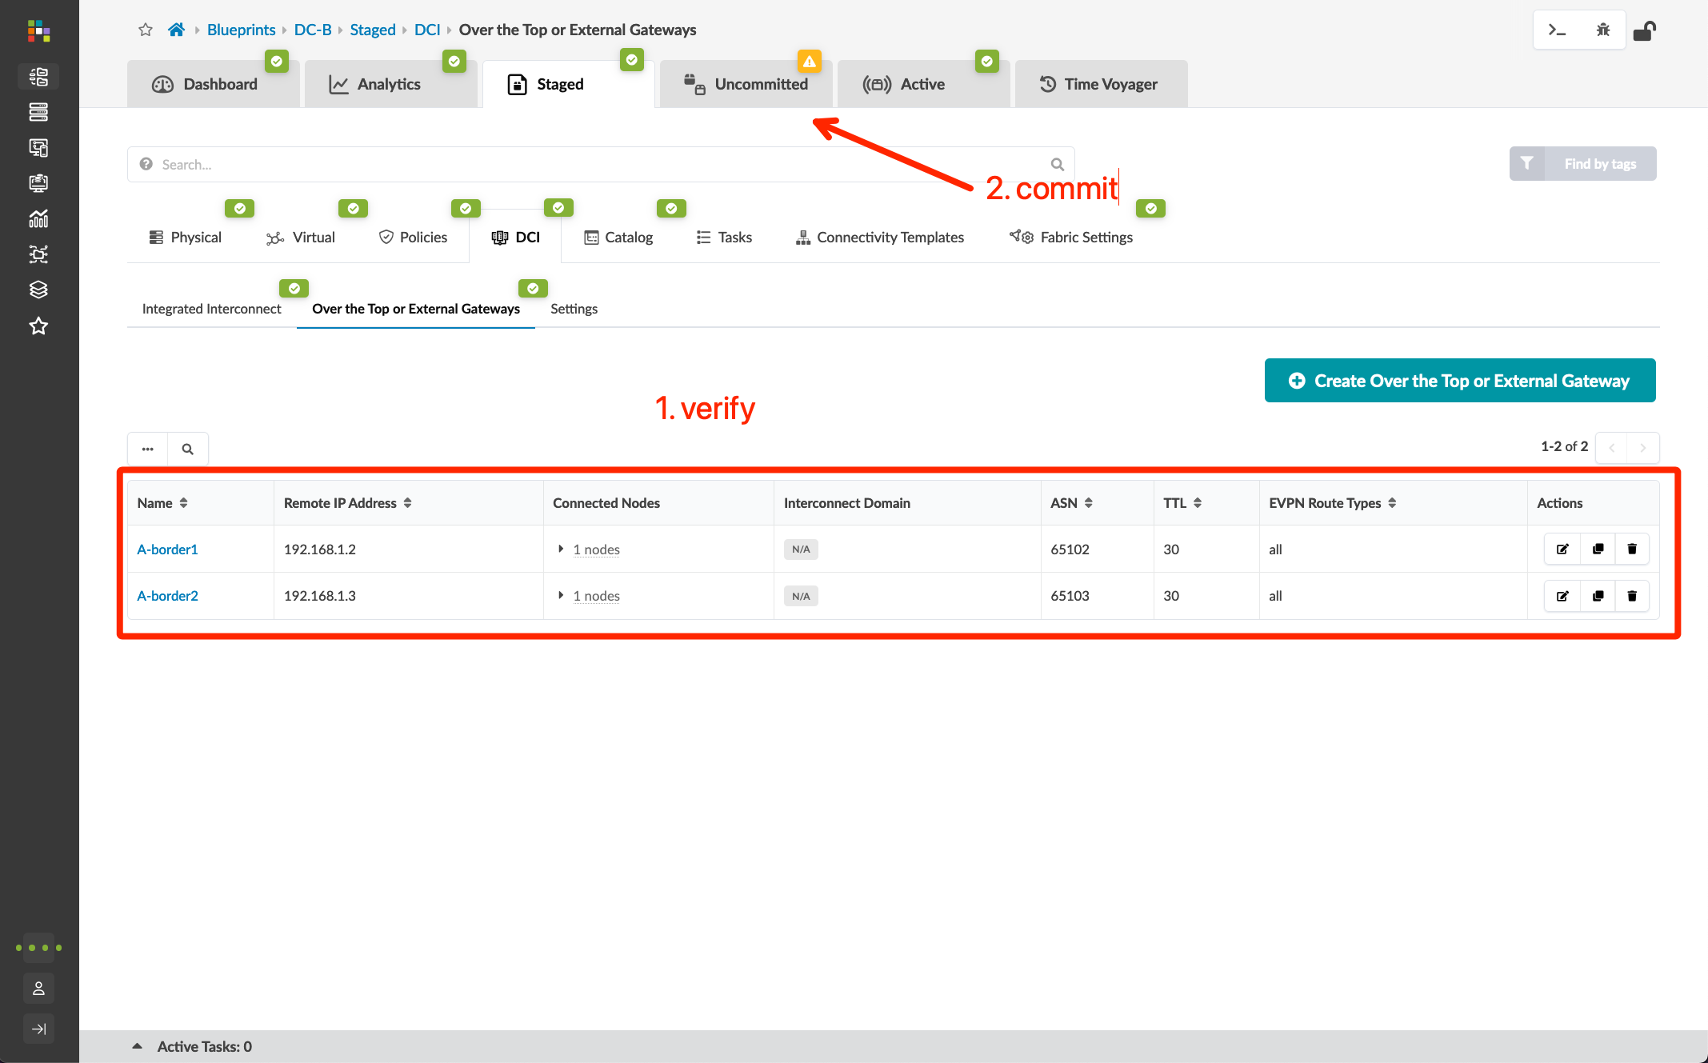
Data Center Interconnect #2 – Overlay
Go to Blueprints > DC-B > Staged > DCI > Settings, click “Modify Settings” button, and change the ESI MAC msb value from 2 to 4
Go to Blueprints > DC-B > Staged > DCI > Over the Top or External Gateways and create EVPN BGP sessions between the local border leafs and the border leafs in DC-A
Commit the Blueprint
Name | IP Address | ASN | Local Gateway
A-border1 | 192.168.1.2 | 65102 | border_rack_dc-b-001_leaf1
A-border2 | 192.168.1.3 | 65103 | border_rack_dc-b-001_leaf2

Slide 33
Initial Setup Complete!
Congratulations! You have built a simple, single-tenant, multi-fabric Apstra lab! The intent of your operational fabrics are shown below.
The following sections focus on enhancements to your lab such as direct DCI peering between spines, WAN/Core connectivity, and some business value demonstrations focused on common operational scenarios.
DC-A Blueprint
Tenant-1 Routing Zone
DC-B Blueprint
Tenant-1 Routing Zone
Stretch L2 OTT DCI
ae1
vn101 (192.168.101.0/24)
ae1
vn101 (192.168.101.0/24)
vn102 (192.168.102.0/24)
ae2
vn103 (192.168.103.0/24)
ae2
To A-leaf1
ge-0/0/7
To A-leaf2
ge-0/0/7
To A-leaf1
ge-0/0/8
To A-leaf2
ge-0/0/8
To A-leaf1
ge-0/0/9
To B-leaf1
ge-0/0/7
To B-leaf2
ge-0/0/7
To B-leaf1
ge-0/0/8
To B-leaf2
ge-0/0/8
A-bms-1_bridge
A-bms-2_bridge
A-bms-3
B-bms-1_bridge
B-bms-2_bridge
vSRX
vSRX
192.168.101.33
vSRX
vSRX
uMate
uMate
uMate
uMate
A-bms-1
A-bms-2
B-bms-1
B-bms-2
192.168.101.11
192.168.102.22
192.168.101.44
192.168.103.55

